Slide 1
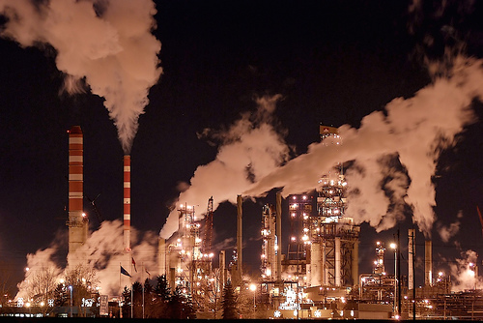

CEEN 525 - Policy Instruments

Slide 2

Notes:
http://cdn.abclocal.go.com/content/creativecontent/images/cms/975436_1280x720.jpg

Slide 4
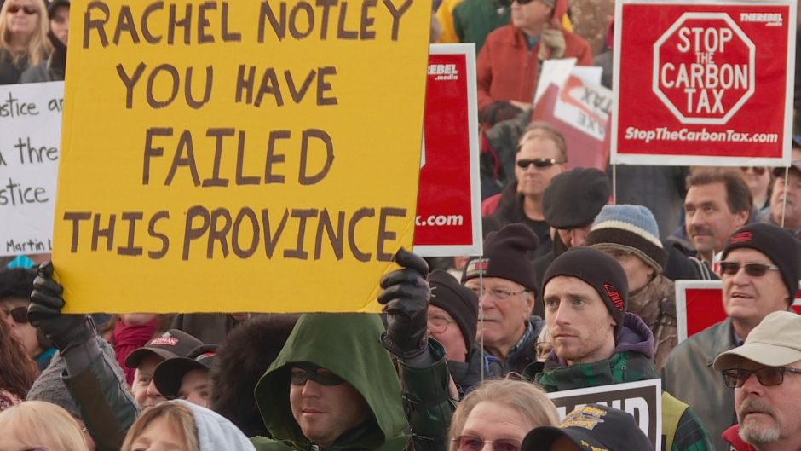

Slide 5
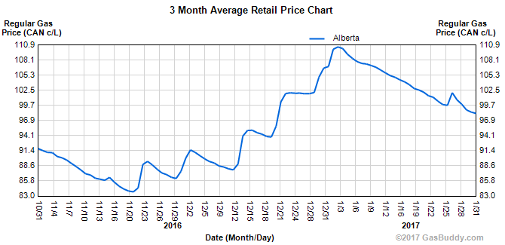
$20/tonne=4.5c/l gasoline, 5.3c/l diesel
http://www.albertagasprices.com/retail_price_chart.aspx

Slide 6
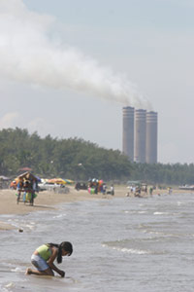
Today’s agenda
Overview – readings and themes
Alternative Policy Instruments
Evaluative criteria
Comparative evaluation
Market failures
Revenue recycling

Slide 7
readings
Mark Jaccard, Sustainable Fossil Fuels, (Cambridge University Press, 2005) pp. 270-290 (on-line through UBC library).
Ecofiscal Commision, Choose Wisely: Options and Trade-offs in Recycling Carbon Pricing Revenues, April 2016.
Mark Jaccard, Mikela Hein and Tiffany Vass, “Is Win-Win Possible? Can Canada’s Government Achieve Its Paris Commitment . . . and Get Re-Elected?” School of Resource and Environmental Management, Simon Fraser University, September 20, 2016 (focus especially on pp. 1-9)

Slide 8
Policy Instruments in Context
actions
energy choices by firms, consumers
policies
rules produced by government that influence actions
Governance
who decides the rules
Objectives (reduce greenhouse gases)
Instruments (carbon tax)
Settings ($40 per tonne CO2e)

Slide 9
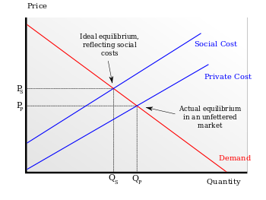
Rationales for Government
Intervention in the Market
externalities
public goods
monopoly
Information
equity

Slide 10
Notes:
http://www.tobaccoreport.ca/2015/TobaccoUseinCanada_2015.pdf

Slide 11
What do you think is the most powerful motivation for most people to take sustainable actions?
good information
social pressure
relative convenience
relative prices
enforceable rules

Slide 12
Toolbox of Policy Instruments –
Jaccard 270-290
command and control regulation
financial disincentives (taxes)
financial incentives (subsidies)
voluntarism and information
market oriented regulations – emissions cap and tradable permits (ECTP)
market oriented regulations – artificial niche market regulations

Slide 13
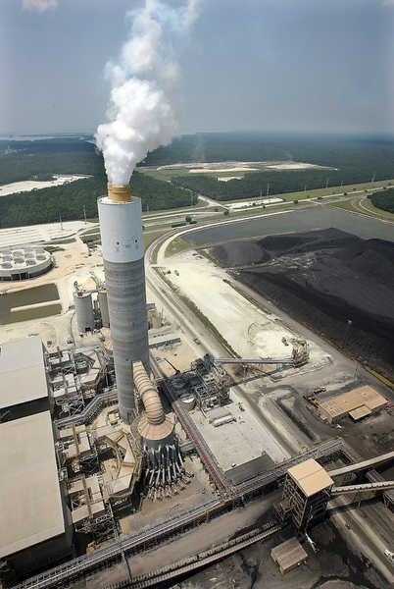
Command and Control Regulation
Legally binding requirement for a specific action
Notes:
Performance standard: coal plants can’t exceed 425 kg of CO2 per Megawatt-hour
Currently not possible without carbon capture and storage (CCS)
Starts in 2015 for new plants + those 50 yrs old

Slide 14

Financial Disincentive - Taxes
Does not prohibit action, but taxes it

Slide 15
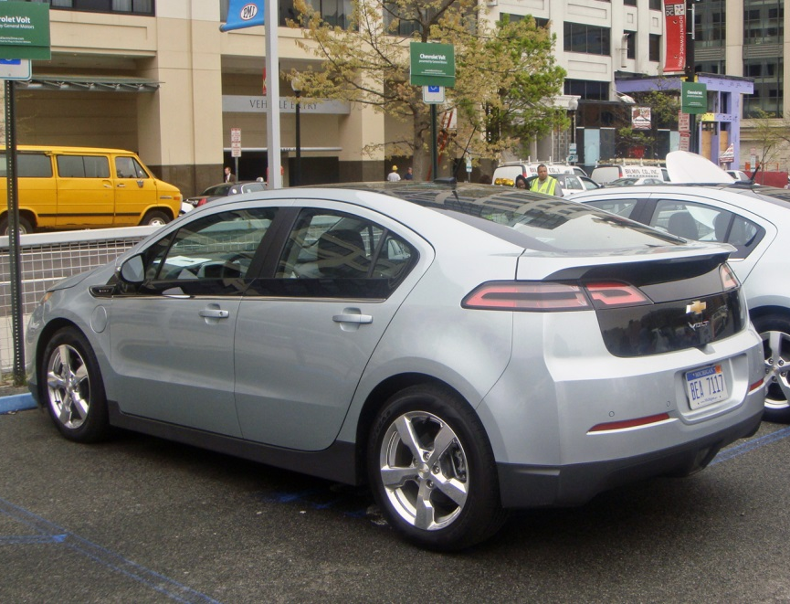
Financial Incentives (Subsidies)
Government spending reduces cost of action

Slide 16


Voluntarism and Information
Can produce more informed decisions about costs and efficacy

Slide 17

market oriented regulations – artificial niche market regulations
Require a certain % of the market to have performance characteristics

Slide 18
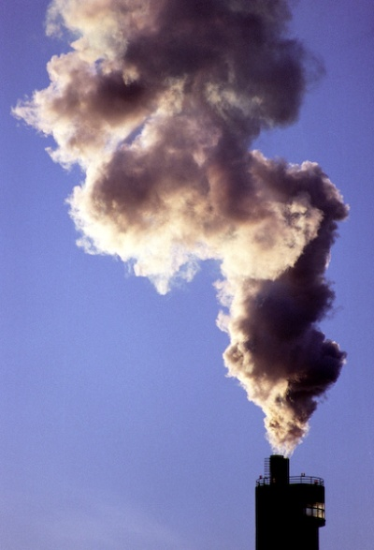
market oriented regulations – emissions cap and tradable permits (ECTP)
Caps total amount of emissions
Distributes tradable allowances (permits) to polluters

Slide 19
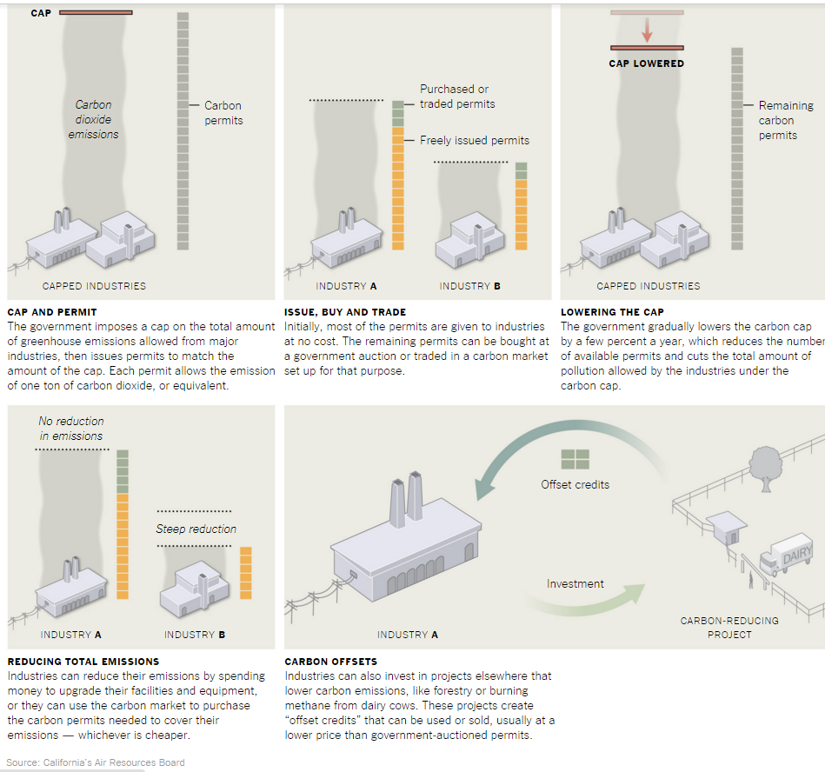
Notes:
http://www.nytimes.com/2014/05/30/science/a-price-tag-on-carbon-as-a-climate-rescue-plan.html?_r=1

Slide 20


Missing Instruments?
State-owned enterprises
Notes:
Klare: 81% of proven reserves controlled by NOCs

Slide 21
Today’s agenda
Overview – readings and themes
Alternative Policy Instruments
Evaluative criteria
Comparative evaluation
Market failures
Revenue recycling

Slide 22
Evaluative Criteria
environmental effectiveness
economic efficiency
administrative feasibility
political feasibility

Slide 23
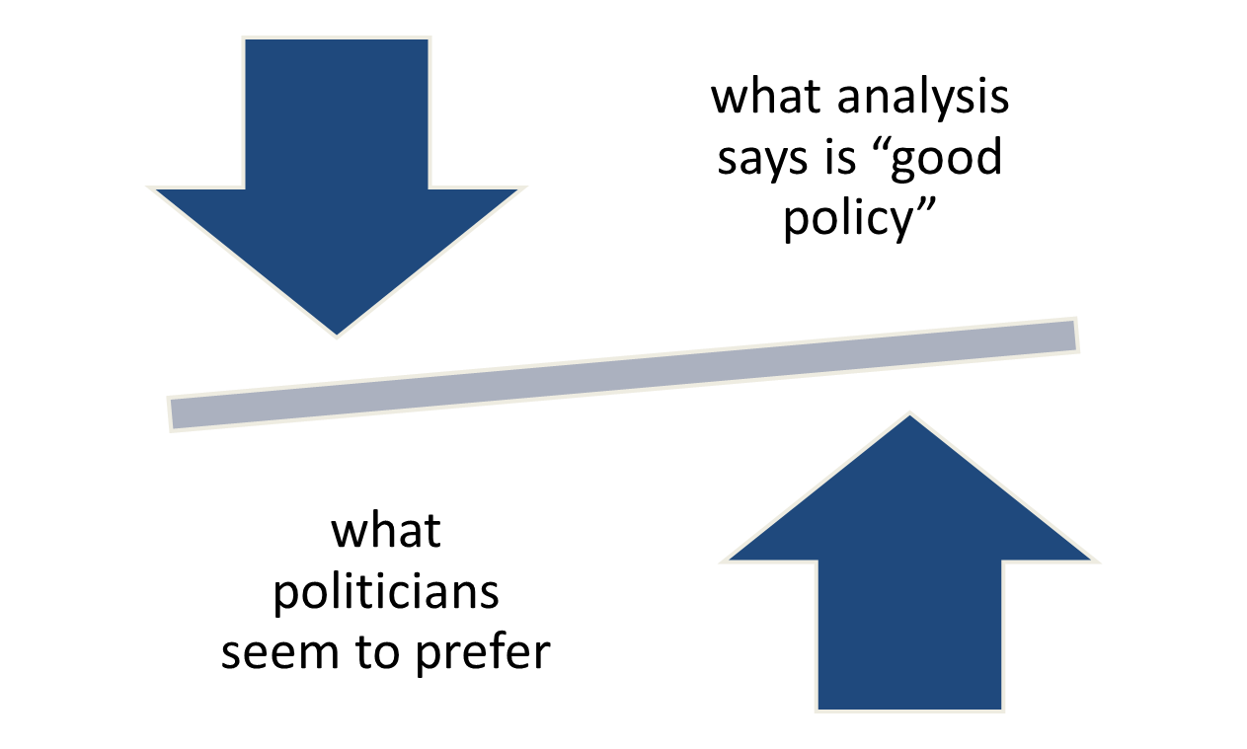
Policy-Politics Mismatch
What works best: instruments that induce or coerce behaviour
  Regulations
  Tradeable permits
  Taxes
What politician tend to prefer:
  Education
  Persuasion
  Voluntary action
  Spending

Slide 24
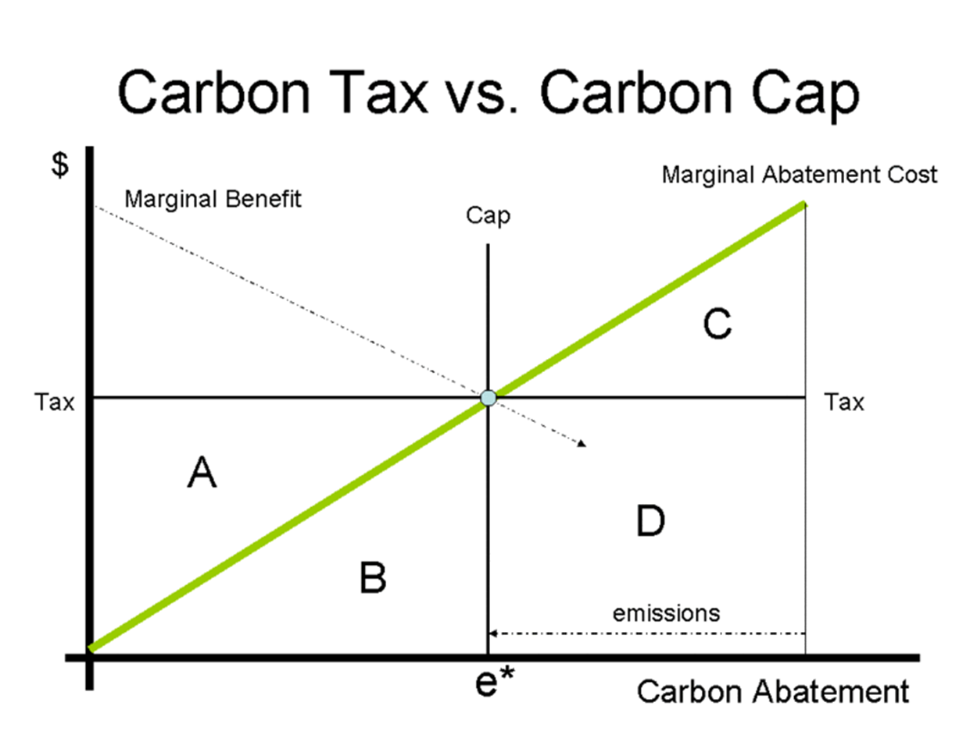

Slide 25
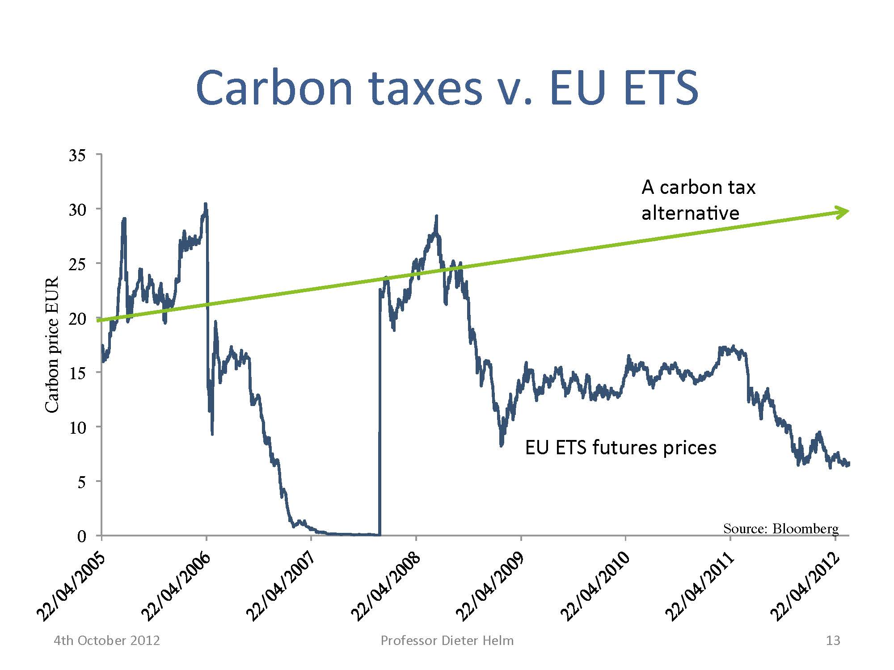

Slide 26
Because of different marginal costs of control, market-based regulations are more cost-effective
 | Pre-mitigation | Regulation: 30% reduction | Cap and trade: 30% reduction
Coal Plant Costs: $20/t | Emissions: 1000 t/yr Costs: 0 | Emissions: 700 t/yr Costs: $6,000 | Emissions: 400 t/yr Costs: $0
Cement Plant Costs: $40/t | Emissions: 1000 t/yr Costs: 0 | Emissions: 700 t/yr Costs: $12,000 | Emissions: 1000 t/yr Costs: $12,000 (to coal plant)
Total | Emissions: 2000 t/yr Costs: 0 | Emissions: 1,400 t/yr Cost: $18,000 | Emissions: 1,400 t/yr Cost: $12,000

Slide 27
Special Challenge of Political Acceptability (Jaccard et al, Win-Win)
Meeting Canada 2030 target would cost $200/tonne
  Politicians unlikely to risk that
    Reviews logic from week 2
      Cost-benefit separation in time and place
      Motivated reasoning – in some jurisdictions creates special bias against taxes
choose policies that do not score highest in term of economic efficiency but instead have a greater chance of political success
Notes:
Direct criticism of ecofiscal approach

Slide 29
Evaluating energy sustainability policy instruments
 | Effectiveness | Efficiency | Administrative Feasibility | Political Feasibility
Info/Persuasion | Poor | Poor | Good | Good
Subsidy | Medium | Poor | Medium | Good
Emission Tax | Medium | Good | Good | Poor
Cap and Trade | Good | Good | Medium | Medium
C&C Regulation | Good | Poor | Good | Medium

Slide 30
Today’s agenda
Overview – readings and themes
Alternative Policy Instruments
Evaluative criteria
Comparative evaluation
Market failures
Revenue recycling

Slide 31
Revenue Recycling - alternatives
Transfer revenue to households
Reduce existing tax rates
Invest in emission-reducing technologies
Invest in critical public infrastructure
Reduce debt
Address competitiveness issues

Slide 32
Revenue Recycling - criteria
Household fairness
Business competitiveness
Economic performance
Environmental performance
Public acceptability

Slide 33
conclusions
A variety of effective tools
Numerous tradeoffs
  Political acceptability vs effectiveness
  Political acceptability vs cost-effectiveness
  On what variable do you most value certainty?
    Price? (then you favour taxes)
    Quantity of emissions (then cap and trade or regs)

Slide 34
Next week: February 7: Formal Government Processes – division of powers, parliamentary government, the legislative process, the regulatory process
George Hoberg, “Forces at Work in Natural Resource Policy – A Hoberg Course Brief,” February 6, 2015.
Legislative Assembly of Alberta, Bill 25 Oil Sands Emissions Limit Act.
Nigel Bankes, “Oil Sands Emission Limit Legislation: A Real Commitment or Kicking It Down the Road?” (3 November, 2016), on-line: ABlawg.
George Hoberg, “Formal Government Processes for Policy Production in Canada – A Hoberg Course Brief,” Greenpolicyprof, September 21, 2015.
Nathalie Chalifour, “The feds have every legal right to set a carbon price,” iPpolitics October 4, 2016.
George Hoberg, “What is the Role of First Nations in Decision-Making on Crown Government Resource Development Projects? – A Hoberg Course Brief,” January 19, 2015.

Slide 35
Mini-brief 2: Your minister has been asked to give a presentation to the International Energy Agency, which has just decided to conduct a review of your country’s energy system and policies. You are tasked with providing an overview of your system of government according to the following template (due February 7 in class)
In 500-1000 words, explain how the formal machinery of government in your jurisdiction works, and include several other contextual indicators. In particular, address each of the following in some way:
Is your jurisdiction generally considered to be democratic or authoritarian? You might find this data set useful.
What electoral system does your jurisdiction use?
Is the legislative-executive system presidential or parliamentary?
What party or parties have been in government (i.e., held executive authority) over the past decade?
Is the system unitary or federal? If federal, give 2 examples of how the division of authority between national and subnational governments influences energy policy.
Where does your jurisdiction stand on widely cited indices of corruption and ease of doing business?
Where does your jurisdiction rank in UN Human Development Index?
Notes (1) if your jurisdiction is subnational, use the national framework for this paper, (2) if your jurisdiction is an international organization, we will need to agree on an alternative classification of the governance structure.

