Slide 1
CEEN 525 Sustainable Energy as a Social and Political Challenge

Slide 2
Full Policy brief
Write a policy brief to the senior government official responsible for energy policy of a significant jurisdiction on policies to achieve decarbonization of a major component of the energy system (e.g., electricity generation, passenger transportation, buildings, etc) by 2050 (or earlier).
Due April 14 by noon.
6000 - 7000 words excluding references (no longer)

Slide 3
Mini-briefs
Mini-brief 1: Define your policy problem. Specify 3-4 criteria and 3-4 alternatives (begin in class January 24, due January 31 by noon).
Mini-brief 2: Your minister has been asked to give a presentation to the International Energy Agency, which has just decided to conduct a review of your country’s energy system and policies. You are tasked with providing an overview of your system of government according to the following template (due February 7 in class)
Mini-brief 3: Your minister… You are tasked with providing an overview of existing energy policy in your jurisdiction as it relates to decarbonization (due March 7 at noon).

Slide 4
Today’s agenda
Why challenge is so formidable (Victor)
Carbon lock-in
Polarization over science

Slide 5
How to read an academic paper
What’s the main argument (or puzzle)?
What subsidiary arguments support it?
Are there underlying or explicit value assumptions?
What evidence is used to support the argument?
Does the evidence support the argument?
Do other (better?) arguments support the observed outcomes?

Slide 6
Feasible of Decarbonization

Slide 7
Victor’s 3 central political challenges
Very deep cuts to GHG emissions are required
Long residence time of CO2 in atmosphere – given rate of emissions stock is hard to reverse
Costs immediate, benefits uncertain and distant in time
“time inconsistency problem”
Global nature of problem creates spatial inconsistency: local costs, global benefits

Slide 8
Hoberg’s version: Why climate action is so hard politically
Cost of Mitigation | Benefits of Mitigation
Here | Global
Now | Distant in Time
Relatively certain | Highly uncertain
Notes:
Concepts:
global public good
energy system inertia and time lag for response to emission reductions
Absence of compelling focusing events?

Slide 9
Victor’s 3 myths about policy process
Scientist’s myth: scientific research can determine the safe level of global warming
Environmentalist’s myth: global warming is a typical environmental problem
Engineer’s myth: once cheaper new technologies are available, they will be adopted
Notes:
Logic of enviro myth a bit harder to follow. Biggest concern is that pressure for universal “fair” agreement doesn’t consider economic motivations and consequences sufficiently

Slide 10
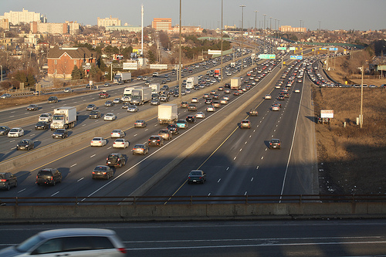
Path Dependence

Slide 12
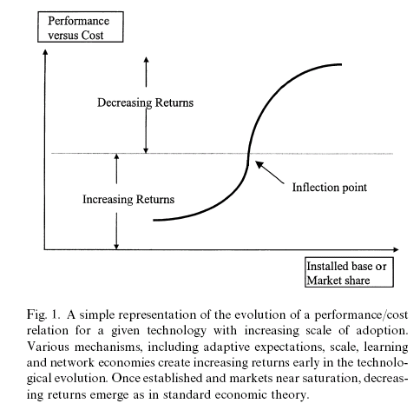

Slide 13
Evolution of technical systems
Increasing returns result from
Scale economies
Learning economies
Adaptive expectations
Network economies

Slide 14
Techno-institutional complex
Not discrete technological artifacts
Complex system of technologies embedded in a powerful conditioning social context of public and private institutions
Technological systems – technological lock-in
Institutional lock-in
Private organizations
governmental

Slide 15
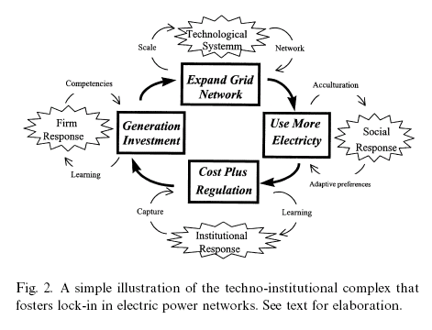

Slide 16
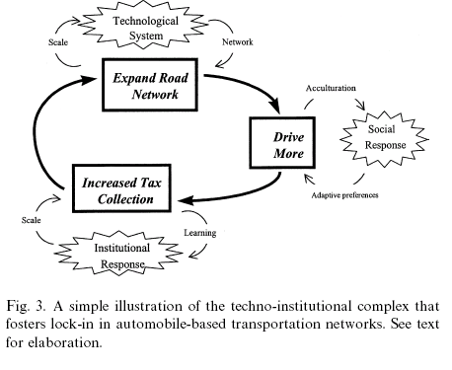

Slide 17
Unruh
Do you find his arguments that the superior technology did not necessarily win out convincing (e.g., AC over DC, ICE over alternatives)?

Slide 18
Science and Politics

Slide 19
Why is there still disagreement on climate science?
Deficit Model: “You just don’t understand”
more information will resolve conflicts and produce appropriate policy response
Members of the public filter their responses to science controversies through their value systems
Social science helps explain how this works

Slide 20
Kahan
According to Kahan et al, does increased knowledge about climate change produce more support for acting to slow it? Why or why not?
What is the cultural cognition thesis? How do they operationalize and measure culture?
What does the cultural cognition thesis imply for science communication?
Are engineers less susceptible to motivated reasoning than others?

Slide 21
Motivated reasoning
motivated cognition: unconscious tendency to fit processing of information to conclusions that suit some end or goal
biased information search: seeking out (or disproportionally attending to) evidence that is congruent rather than incongruent with the motivating goal
biased assimilation: crediting and discrediting evidence selectively in patterns that promote rather than frustrate the goal
identity-protective cognition: reacting dismissively to information the acceptance of which would experience dissonance or anxiety.
Daniel Kahan, “What Is Motivated Reasoning and How Does It Work?, Science and Religion Today May 4, 2011.

Slide 22
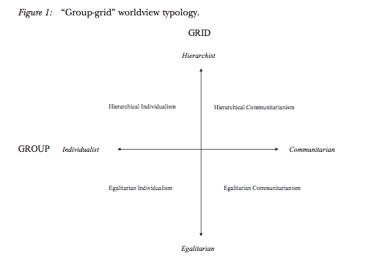

Slide 23
If arguing science isn’t going to work, how would you convince a conservative climate skeptic of the need for climate action?

Slide 24
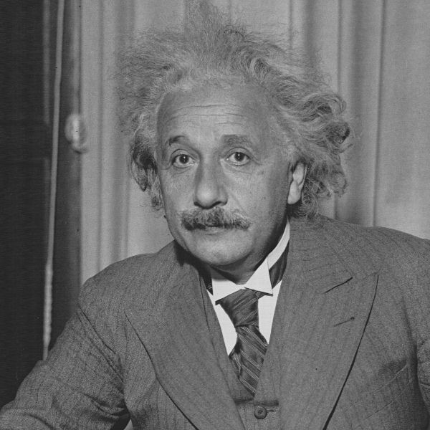
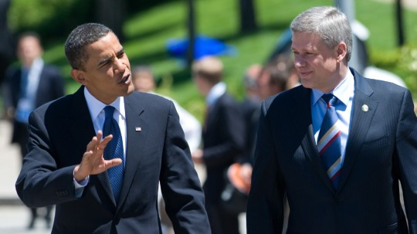
The politics of science: Classic view: separation
Science
(facts)
Truth
Politics
(values)

Slide 25
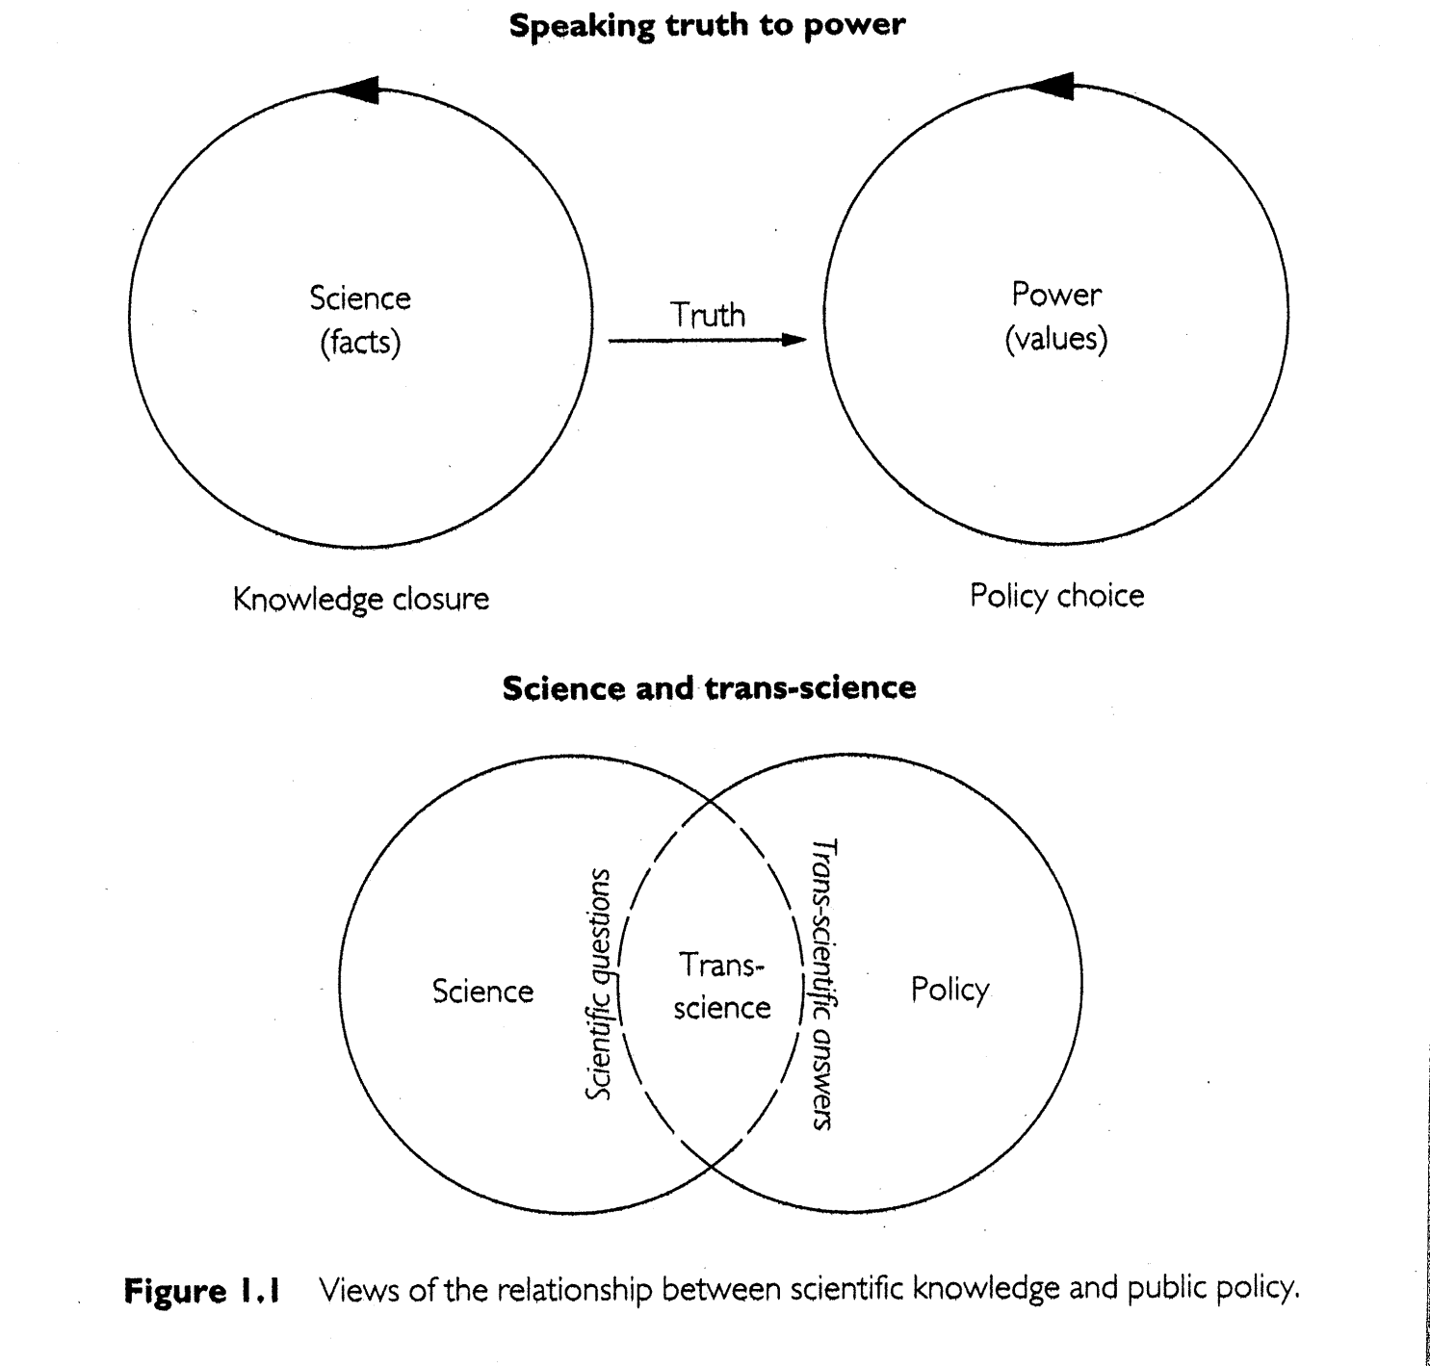
Politics of Science: Recognition of “Trans-science”
Jasanoff and Wynne 1998

Slide 26
Politics of Science Constructivist View
Politics
Science
Notes:
Comes from the view that values so inevitably cloud scientific judgements that any effort to separate the factual and value basis of decision making is fruitless

Slide 27
Politics of Science Constructivist View (when pressed)
Politics
Science
Notes:
Reality might exist and we might be able to use science pretty well to represent it, but that general doesn’t apply to interesting case

Slide 28
Politics of Science Psychologists view
Motivated reasoning helps explain the politicization of science
Scientific controversies mask underlying value differences

Slide 29
Wrapping up
Clean energy solutions to climate change confront vexing problems
Clean energy transition constrained by carbon-based socio-technical energy system
The politics of science:
Motivated reasoning means scientific controversies are frequently more about underlying value conflicts (e.g., free of growing government)
Notes:
Great source:
Mike Hulme, Why we disagree about Climate Change, chap 3
Chris Mooney, Do Scientists Understand the Public
Collected works of Sheila Jasanoff

Slide 30
Next week
Carl Patton and David Sawicki, Basic Methods of Policy Analysis and Planning, (Englewood Cliffs, NJ: Prentice Hall, 1993), 2nd Edition, selected pages. (to be distributed)
4 tutorials on policy analysis provided by the professor Tutorial text http://frst523.forestry.ubc.ca/simulation/tutorials-text/ or Tutorial videos http://frst523.forestry.ubc.ca/simulation/tutorials-video/
Case study TBA
By Tuesday noon, fill out the emailed spreadsheet for your jurisdiction and part of the energy system
For class, bring in a one-sentence problem definition
Mini-brief 1: Define your policy problem. Specify 3-4 criteria and 3-4 alternatives (begin in class January 24, due January 31 by noon).

