Slide 1
CEEN 525 Actor Dynamics

Slide 2
Policy Brief: Write a policy brief to the senior government official responsible for energy policy of a significant jurisdiction on policies to achieve decarbonization of a major component of the energy system (e.g., electricity generation, passenger transportation, buildings, etc) by 2050 (or earlier). Due April 14 by noon. You must get the instructor’s approval of the topic. The brief must apply the 6-tep policy analysis framework developed in the course. Length should be between 6000 and 7000 words excluding references (no longer). You are encouraged to incorporate all or parts of your mini-briefs in this final brief. Further details will be provided in due course.

Slide 3
Elements of paper
Introduction – address memo to real person
Context of your jurisdiction (paper 2)
Current policy (paper 3)
6 step policy analysis
Starts with paper 1

Slide 4
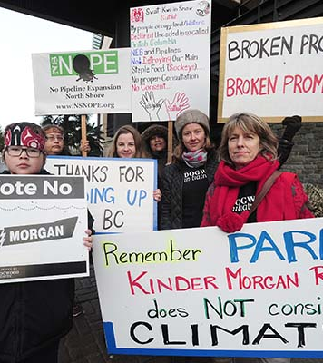
Today’s agenda
Policy Cycle
Government actors - incentives
Interest Groups – Interests, Resources, Strategies
Stakeholder analysis
Political Risk Analysis
Mid-term review

Slide 5
Policy Cycle Model
Agenda-Setting
Policy Formulation
Decisionmaking
Policy Implementation
Monitoring and Evaluation

Slide 6
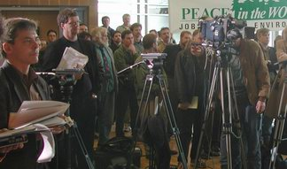
Agenda-Setting – Definitions
Social Agenda (general, systemic): issues that the public thinks deserve attention from government
measures: polls, media
Government Agenda (formal): issues explicitly up for active and serious consideration by policy makers
measures: announced proposals, throne speech, mandate letter

Slide 7
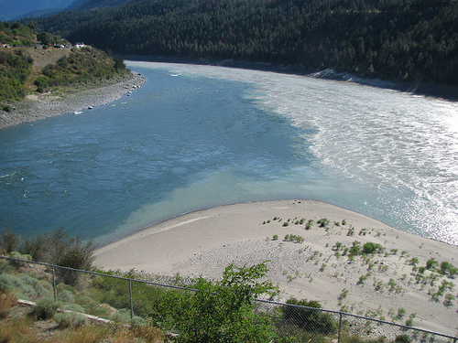
Kingdon’s “multiple streams” model
a confluence of
Problem stream
Politics stream
Policy (solution) stream
Opens a “policy window”
Opportunity for “policy entrepreneurs”

Slide 8
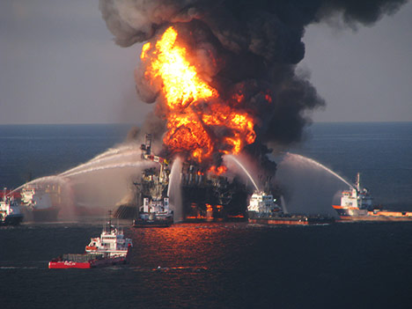
Agenda-Setting - Process
Changes in “Problem”
indicators
knowledge, technology
focusing event
Changes in “Politics”
changing public mood
elections
interest group strategies

Slide 9
“Most important problem”
US
BC May 2016

Slide 10
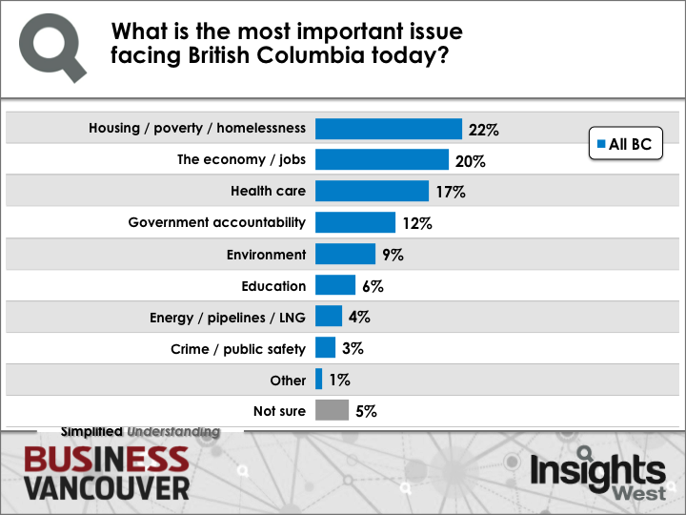

Slide 11
Policy Cycle Model
Agenda-Setting
Policy Formulation
Decisionmaking
Policy Implementation
Monitoring and Evaluation

Slide 12
Today’s agenda
Policy Cycle
Government actors - incentives
Interest Groups – Interests, Resources, Strategies
Stakeholder analysis
Political Risk Analysis
Mid-term review

Slide 13
Interest groups in context
Strategic actors
Government
Elected officials
Bureaucrats
Non-government interest groups

Slide 14
Todays theme: Actors in the policy process have interests and resources, and adopt strategies design to best use those resources in pursuit of their interests

Slide 15
Government Actors -Interests, Resources: Politicians
resource: authority
Objectives: reelection, policy objectives, power
reelection comes first -- fundamental constraint
effect: public opinion matters

Slide 16
The Impact of Public Opinion on Public Policy: BURNSTEIN
impact of public opinion is substantial
salience enhances the impact of public opinion
impact of opinion remains strong even when the activities of political organizations and elites are taken into account
responsiveness appears not to have changed significantly over time
Notes:
Limits: especially important, relatively simple, and addressed by legislatures straightforwardly, but such issues are few
Salient: prominent or conspicuous

Slide 17
Government Actors –Interests, Resources: Bureaucrats
resources
authority
expertise
objectives
policy objectives
power (budgets, jurisdiction)
autonomy

Slide 18
Today’s agenda
Policy Cycle
Government actors - incentives
Interest Groups – Interests, Resources, Strategies
Stakeholder analysis
Political Risk Analysis
Mid-term review

Slide 19
Interest Groups
energy firms
trade associations
environmental NGOs
aboriginal groups
consumer groups (?)

Slide 20
Group Resources
money
expertise (substance, process)
skilled leadership (effective, charismatic)
appealing cause
public opinion
contacts
control over investment, jobs
Notes:
List from Schlossman and Tierney, Organized Group in American Politics, with adaptation

Slide 21
Group Resources – The Privileged Position of Business
control over investment, jobs
government seeks reelection
reelection depends on jobs, healthy economy
jobs, growth created by investment
investment a function of business climate
government constrained from undermining business climate
Notes:
Charles Lindblom, “The Market as Prison.”

Slide 22
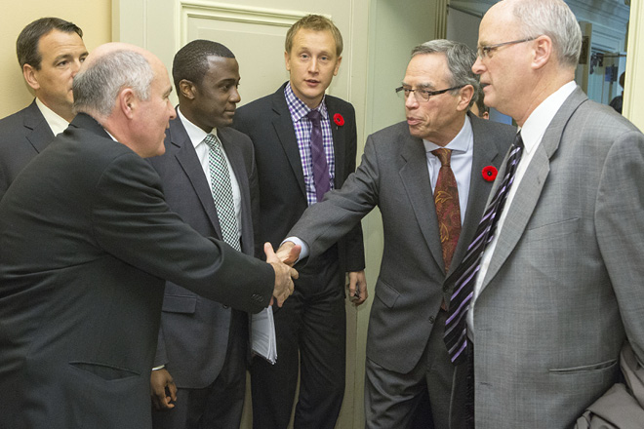
Actors Strategies – First order
lobby
influence public opinion
finance elections
form coalitions
direct action

Slide 23
Actors Strategies– Second Order
change the rules
venue shifting
framing

Slide 24
Stakeholders
Some not formally organized as groups
Stakeholder attributes
Power
Legitimacy
Urgency
Position value (favor, oppose, neutral)
Vested interest impact level
Level of impact
Probability of impact
Power/Interest Grid

Slide 25
Today’s agenda
Policy Cycle
Government actors - incentives
Interest Groups – Interests, Resources, Strategies
Stakeholder analysis
Political Risk Analysis
Mid-term review

Slide 26
Political Risk Analysis

Slide 27
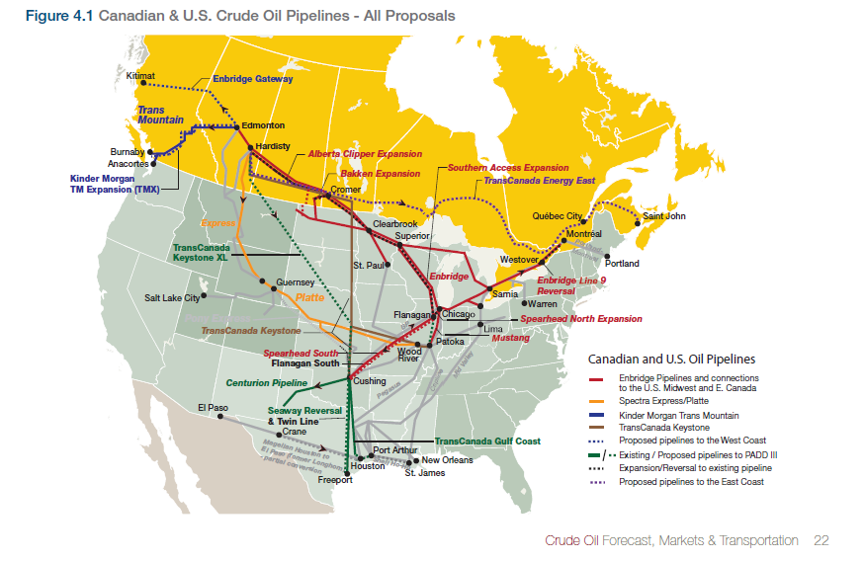
CAPP 2014 http://www.capp.ca/getdoc.aspx?DocId=247759

Slide 28
The Four Major Projects
Project | Company | Capacity (bpd) | Location | Status
Keystone XL | TransCanada | 830,000 | Alberta to US Gulf Coast | Rejected by US government
Northern Gateway | Enbridge | 525,000 | Alberta to BC Coast | Approved with conditions
TransMountain Expansion | Kinder Morgan | 590,000 | Alberta to BC Coast | Hearing concluding, awaiting NEB decision
Energy East | TransCanada | 1,100,000 | Alberta to Atlantic Canada | Hearings underway

Slide 29
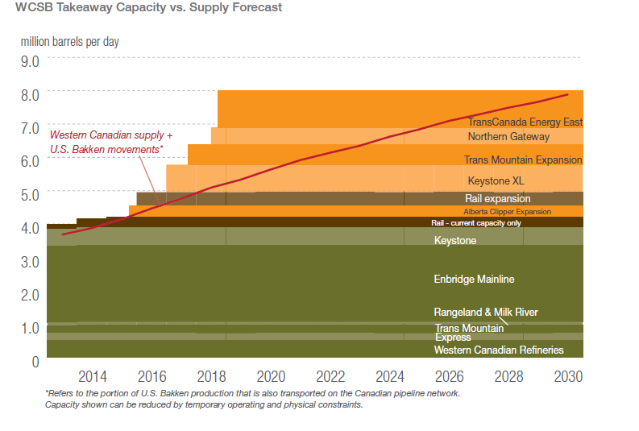
Pipeline capacity vs oil sands growth
http://www.capp.ca/getdoc.aspx?DocId=247759

Slide 30
Analytical Framework
Veto points
Any institution with authority to block project
Problem structure – distribution of costs and benefits
Are impacts concentrated or diffuse
Concentrated: oil spills, industry profits
Diffuse: climate impacts, tax revenues
Are environmental risks and economic benefits separated across veto points

Slide 31
Political Risk Factors
the probability of success of any particular proposal depends on the relative balance of power of the pro- and anti-pipeline coalitions within the relevant jurisdictions.
Political risk is a function of:
number of institutional veto points
whether opposition groups have access to veto points
whether the project can take advantage of existing infrastructure
the salience of place-based, concentrated environmental risks
the jurisdictional separation of risks and benefits

Slide 32
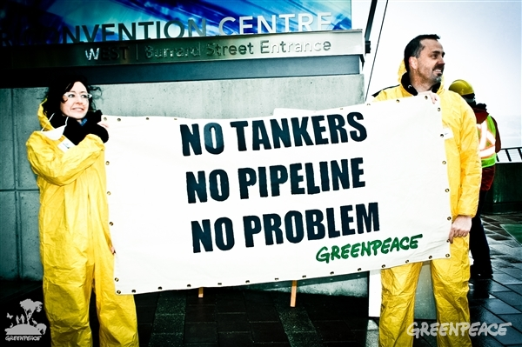
Strategic Actors
Pipeline companies
Oil sands companies
Refineries
Environmentalists
Spill risks
climate
Aboriginal groups
Landowners
Governments

Slide 33
Institutions
United States
Canada
Divided government (pre-2017
Presidential government
Adversarial legalism
State control of pipeline siting
Conservative Majority
Leader-centred parliamentary system
Enabling legislation
Provincial control of land and resources
Federal paramountcy
First Nations with strong rights

Slide 34
Table 2 – The Political Risks of Five Oil Sands Pipeline Proposals
 | Keystone XL | Northern Gateway | Kinder Morgan Expansion | Line 9 | Energy East
Veto points | High | High | High | Medium | Medium
Opposition access to veto points | Medium | High | High | Medium | Medium
Need for new infrastructure | High | High | Medium | Low | Medium
Concentrated risks | Medium | High | High | Medium | Medium
Risk-benefit separation | High | High | High | Low | Low

Slide 35
Wrap up
Policy cycle
Actors
Interests
Resources
Strategies
Political Risk Analysis

Slide 36
Midterm Review
How would you describe the workload for this class relative to your other classes this term?
Substantially less
Somewhat less
About the same
Somewhat more
Substantially more

Slide 37
Remaining Topics: Those in red could be switch to other topics
February 28: Energy Planning and Approval Strategies, and the Challenge of Social License
March 7: Energy Poverty – The Challenge and Case Studies
March 14: Trump, California, and Energy Policy in the United States
March 21: Case Study in Policy Innovation: Germany's Energiewende
March 28 – International Trade and Clean Energy Policies
April 4: Transitions, Synthesis, Reflections

Slide 38
Midterm Review
Thinking forward to the rest of the term, what areas of course delivery or content do you think could be improved?

Slide 39
February 28: Energy Planning and Approval Strategies, and the Challenge of Social License
Mark Jaccard, Noel Melton, and John Nyboer, “Institutions and Process for scaling up renewables: Run-of-river hydropower in British Columbia,” Energy Policy 39 (2011): 4042-4050. (available through UBC library on line)
Michael Cleland et al, A Matter of Trust: The Role of Communities in Energy Decision-Making, University of Ottawa and Canada West Foundation, November 2016.

