Slide 1
CEEN 525 Formal Government Processes

Slide 2
Mini-brief 2: Your minister has been asked to give a presentation to the International Energy Agency, which has just decided to conduct a review of your country’s energy system and policies. You are tasked with providing an overview of your system of government according to the following template (due February 7 in class)
In 500-1000 words, explain how the formal machinery of government in your jurisdiction works, and include several other contextual indicators. In particular, address each of the following in some way:
Is your jurisdiction generally considered to be democratic or authoritarian? You might find this data set useful.
What electoral system does your jurisdiction use?
Is the legislative-executive system presidential or parliamentary?
What party or parties have been in government (i.e., held executive authority) over the past decade?
Is the system unitary or federal? If federal, give 2 examples of how the division of authority between national and subnational governments influences energy policy.
Where does your jurisdiction stand on widely cited indices of corruption and ease of doing business?
Where does your jurisdiction rank in UN Human Development Index?
Notes (1) if your jurisdiction is subnational, use the national framework for this paper, (2) if your jurisdiction is an international organization, we will need to agree on an alternative classification of the governance structure.

Slide 3
outline
Overview
Oil Sands Emission Limit Act
Canadian energy governance
Federalism in Canada
Case Study: NEP
Canadian (and BC) government
Aboriginal rights

Slide 4
Overview
Governance in 2 stages
Formal procedures
Next week: (informal) processes; actor dynamics
Core distinction:
Authority: ability to make rules backed up by coercive power of the state
Power/influence: ability to influence outcomes
Today: foundations for authority

Slide 5
Legislative Assembly of Alberta, Bill 25 Oil Sands Emissions Limit Act
What limit does it place on oil sands emissions?
What exemptions does it make?
Are those exemptions justified?
Note: oil sands emissions in 2014 were about 68 million tonnes

Slide 6
Governance in Context
actions – behavioural actions
energy choices by firms, consumers
policies – rules produced by government that influence actions
Objectives (increase renewable electricity)
Instruments (renewable portfolio standard)
Settings (10% by 2012)
governance – who decides the rules

Slide 7
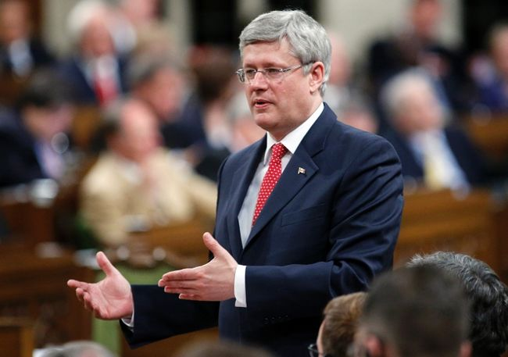
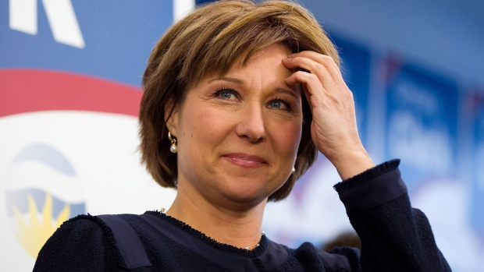
Governance – 3 Core Questions
Who decides?
Who participates?
At what level of government? (vertical dimension)

Slide 8
Vertical Dimension – Division of Powers
provincial
federal
91 –international and interprovincial trade
91 –tax any mode or means
Spending
Fisheries and navigation
General
criminal law
Peace, order, good government
109 – all lands, mines, minerals, and royalties to the provinces
92 – provincial management and sale of public lands (federal jurisdiction over “Canada Lands”)
What about local government? International government?

Slide 9
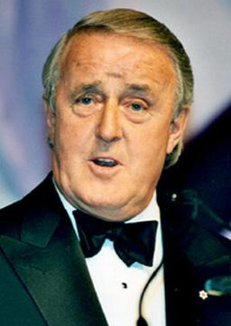
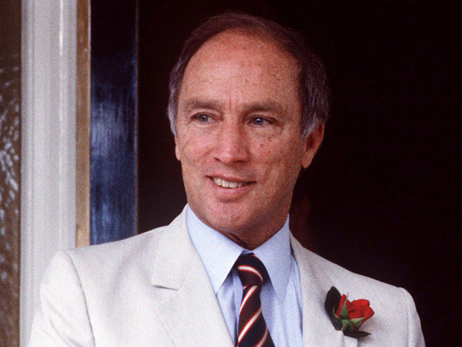
The Ghost of Trudeau’s Father: The Enduring Legacy of the 1980 National Energy Program
Pierre Trudeau, Prime Minister of Canada, 1968-1979, 1980-4 (Liberal Party of Canada). Father of Justin Trudeau
Brian Mulroney, Prime Minister of Canada, 1984-93 (Progressive Conservative Party). Father of Ben Mulroney

Slide 10
Why history lesson?
Can’t understand current Canadian energy policy and governance without it
Context:
Two most important problems in Canadian politics: Quebec and relations with US
In Canadian federal-provincial relations, energy second only to Quebec

Slide 11
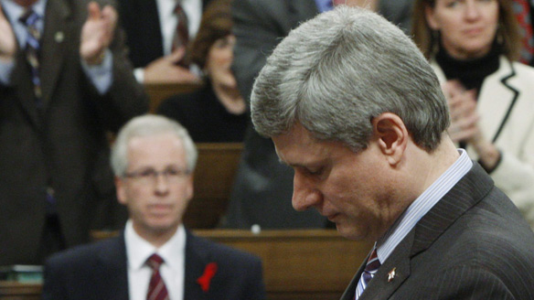
NEP Enduring legacy
“It’s like the national energy program in the sense that the national energy program was designed to screw the West and really damage the energy sector. This is different in that it will actually screw everybody across the country.”
Prime Minister Stephen Harper, during 2008 election campaign, on Stephan Dion’s carbon tax

Slide 12
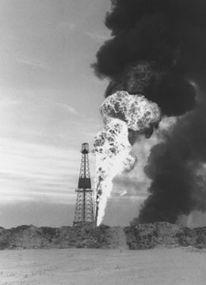
Prelude to NEP 1957-1961
1959 – National Energy Board Created
1961 – National Oil Policy
two market policy
east of Ottawa Valley, cheap imported Venezuela oil
Ontario and west, more expensive Canadian oil
delivered by Trans-Canada Pipeline
continental price under umbrella of US protectionism
growing exports to US
Rapid growth in oil and gas industry

Slide 13
Prelude to NEP 1973-1980
1973 – OPEC oil embargo
link to global geo-politics: Arab-Israeli War
price controls on domestic crude oil and natural gas
subsidized consumption by refiners through oil import compensation program (OICP)
1975 – Petro-Canada established
foster resource development
increase federal government information about reserves
1979 – Iranian revolution led to world price doubling
gap between Canadian prices and world prices increased
Notes:
price of natural gas to be kept below the price of oil to encourage substitution

Slide 14
1980 Political Economy of Energy in Canada
Oil coalition: federal Conservative Party, western provincial governments, and oil industry
rapid convergence to world prices
smaller federal share of revenues
privatization of Petro-Canada
enabling foreign ownership
Federal Coalition: federal Liberal and NDP Party, central and eastern provincial governments
slower increase in prices
larger federal share of revenues
strengthening of Petro-Canada
regulation on foreign ownership

Slide 15
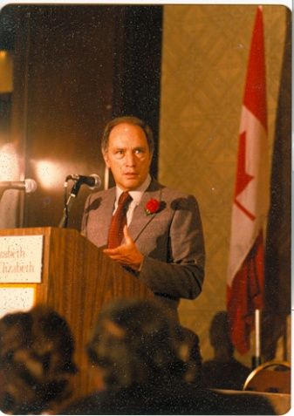
National Energy Program
October 1980 budget
“a centralist, nationalist and interventionist political and policy initiative which at its core was intended to substantially restructure the key relationships of power and the sectoral and regional distribution of wealth in Canadian energy politics” (Toner and Bregha 1984).

Slide 16
National Energy Program 1980
3 goals
security of supply
Petroleum Incentive Program (PIP) encouraged exploration and development
Canadianization
50% Canadian ownership by 1990 (from 29%)
PIP criteria favoured Canadian firms on Canada Lands
enlarge Petro-Canada through acquisitions
interregional equity in price and revenue sharing
8% Petroleum and Gas Revenue Tax (PGRT)

Slide 17
Backlash Against NEP cbc retrospective video
Universal industry opposition
Vehement opposition by Alberta – led by Premier Peter Lougheed
cutback in oil production
cancellation of 2 oil sands projects
Compromise of 1981 produced a new pricing system
old domestic oil increased to 75% world price
new conventional oil at world price
Notes:
Popular bumper sticker: let the eastern bastards freeze in the dark

Slide 18
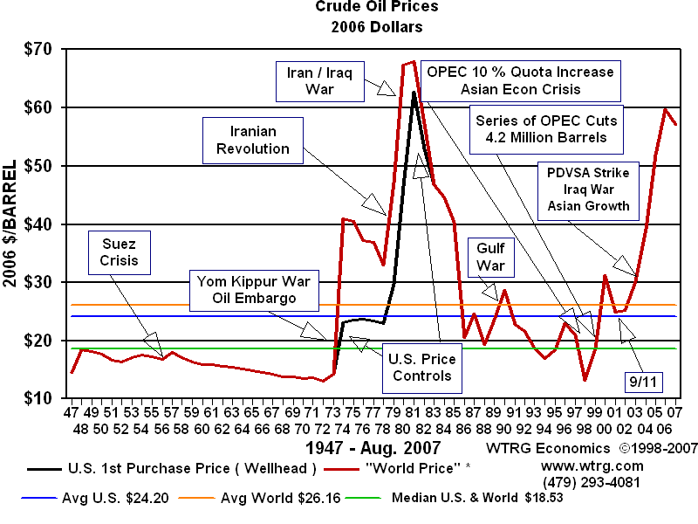
Demise of NEP
Beginning in 1982, world oil prices began to plummet

Slide 19
Demise of the NEP
Oil price decline after 1982
Mulroney Era (Progressive Conservative) begins in Fall 1984
Western Accord effectively dismantled NEP

Slide 20
NEP Enduring Legacy
Lesson: mistaken federal government overregulation
Strengthened Alberta’s anti-Ottawa tendencies
Revived as a bogey-man to discredit major federal energy-related initiatives including climate action

Slide 21
outline
Overview
Oil Sands Emission Limit Act
Canadian energy governance
Federalism in Canada
Case Study: NEP
Canadian (and BC) government
Aboriginal rights

Slide 22
Government in Canada
http://www.youtube.com/watch?v=yi1yhp-_x7A

Slide 23
Parliamentary Government –Executive
Queen’s Representative
Governor General (Federal)
Lieutenant Governor (Provincial)
Prime Minister (Federal) or Premier (Provincial)
Cabinet
Notes:
PM/Premier is the leader of the party that can maintain the confidence of the house

Slide 24
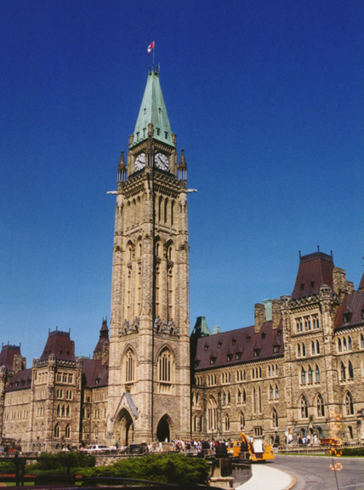
Parliamentary Government – A Misnomer?
MP – member of Parliament (federal)
MLA – members of legislative assembly (provincial)
influence limited by
majority rule – government must have support of majority
party discipline – all members must vote how their party tells them to
Party policy set by caucus – in reality by cabinet and especially leader

Slide 25
Is “Parliamentary Government” a misnomer?

Slide 26
Organization of legislature
Caucus
Cabinet
Opposition critics (shadow cabinet)
Backbencher

Slide 27
Party composition of Parliament House of Commons – 338 seats

Slide 28
Votes and Seats – House of Commons 2011 + 2015
 | Vote % 2011 | Seat % 2011
Conservative | 40 | 53
NDP | 31 | 33
Liberal | 19 | 11
BQ | 6 | 1
Green | 4 | 0.3
Notes:
LPC 39.6% of vote give 54% of seats. CPC 31.9% votes, 29.2% seats. NDP 19.7% votes 13.0% seats #elxn42

Slide 29
Votes and Seats – House of Commons 2011 + 2015
 | Vote % 2011 | Seat % 2011 | Vote % 2015 | Seat % 2015
Conservative | 40 | 53 | 32 | 29
NDP | 31 | 33 | 20 | 13
Liberal | 19 | 11 | 40 | 54
BQ | 6 | 1 | 5 | 3
Green | 4 | 0.3 | 3 | 0.3
Notes:
LPC 39.6% of vote give 54% of seats. CPC 31.9% votes, 29.2% seats. NDP 19.7% votes 13.0% seats #elxn42

Slide 30
Provincial Party Balance
BC – 85 SEATS
Alberta – 87 seats
BC Liberal (49) - 58%
New Democrat (34)
Green (1)
NDP (54) 62%
Wildrose (22) 25%
Conservatives (8) 9%
Liberal (1)
Alberta Party (1)
Vacant (1)

Slide 31
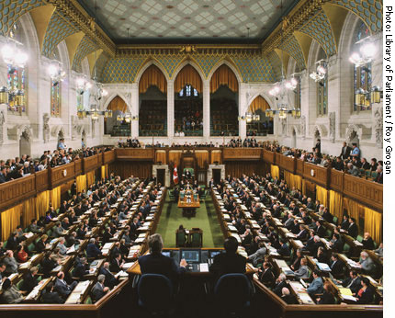
Forms of Law
statute
enabling legislation
Act of legislature
regulation
delegated legislation
order in council
cabinet (informal)
lieutenant governor (formal)
contracts, permits
Notes:
Special direction 10 http://www.gov.bc.ca/empr/down/special_direction_1923_001.pdf

Slide 32
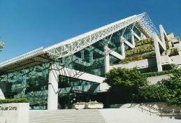
Judicial Branch
Provincial Courts
Federal Court of Appeals
Supreme Court of Canada
Very little role in energy policy except for aboriginal rights

Slide 33
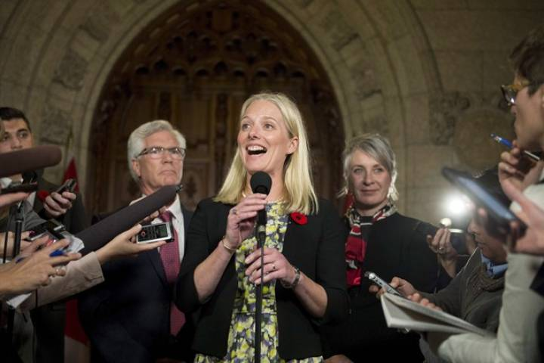
Bureaucracy
Ministers (elected)
Appointed Officials (bureaucrats)
Special type: Independent regulatory commission

Slide 34
Essential Elements of Authority
Division of powers
Head of state
PM or premier
Cabinet
Members of legislature
Legislatures
Minister
Appointed officials
Agencies
Courts

Slide 35
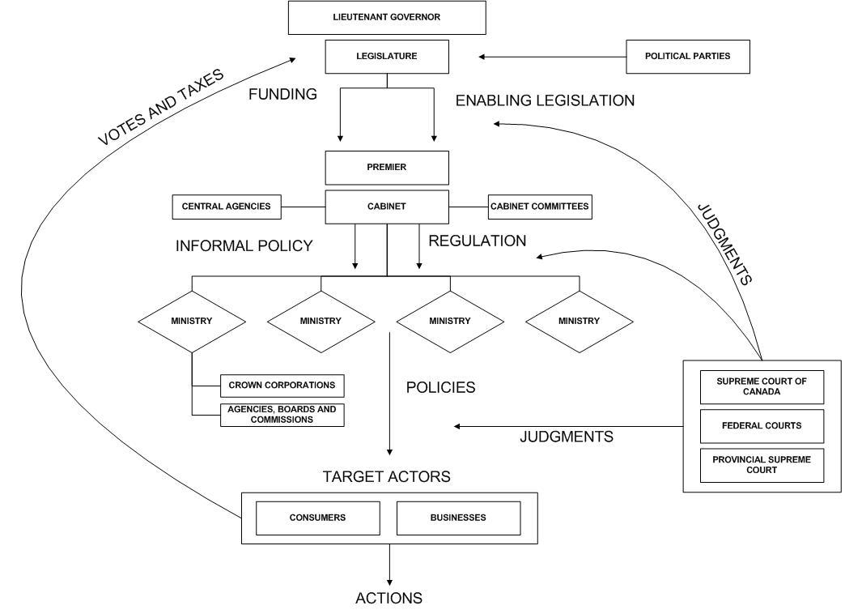
Diagram

Slide 36
outline
Overview
Oil Sands Emission Limit Act
Canadian energy governance
Federalism in Canada
Case Study: NEP
Canadian (and BC) government
Aboriginal rights

Slide 37
Aboriginal Rights and Title Crown government duty: consult and accommodate

Slide 38
Aboriginal Rights and Title
Governments have a duty to consult and accommodate First Nations (Haida)
Not a veto (Haida, Taku)
“Free, prior and informed consent” from UN Declaration
Non-binding on signatories
Canada late signatory with condition that FPIC not a veto
Obligations involved in accommodate uncertain

Slide 39
Supreme Court Tsilhqot’in - infringement
The right to control the land conferred by Aboriginal title means that governments and others seeking to use the land must obtain the consent of the Aboriginal title holders. If the Aboriginal group does not consent to the use, the government’s only recourse is to establish that the proposed incursion on the land is justified under s. 35 of the Constitution Act, 1982. (paragraph 76)

Slide 40
Supreme Court Tsilhqot’in - infringement
To justify overriding the Aboriginal title-holding group’s wishes on the basis of the broader public good, the government must show: (1) that it discharged its procedural duty to consult and accommodate, (2) that its actions were backed by a compelling and substantial objective; and (3) that the governmental action is consistent with the Crown’s fiduciary obligation to the group (paragraph 77)

Slide 41
Supreme Court Tsilhqot’in – new confusion
Fiduciary duty, in Canadian aboriginal law, simply means balancing aboriginal rights with other interests
What the 3rd condition adds is uncertain, and how this decision changes the balance of rights, is uncertain and will only be clarified by future court decisions
Notes:
http://www.parl.gc.ca/content/lop/researchpublications/prb0009-e.htm

Slide 42
Supreme Court Tsilhqot’in - infringement
Consent
Or justify infringement
Consult
Compelling objective
Meet fiduciary obligation
http://raventrust.com/case/tsilhqotin-nation/

Slide 43
Hoberg’s hypothesis
while the law falls short of granting a right of consent to First Nations, it is now politically impossible for natural resource projects in Canada to proceed if there is significant opposition from directly affected First Nations
Notes:
http://www.parl.gc.ca/content/lop/researchpublications/prb0009-e.htm

Slide 46
Summary
Authority vs power
Formal bases for policy in statute and regulation
provincial dominance
executive dominance
Increasing aboriginal power, within limits

Slide 47
Next week – Actor Dynamaics
CEEN 525 February 14: Actor Dynamics – actors in the policy process (government and interest groups): interests, resources, strategies
Rachel Thompson, “Stakeholder Analysis: Winning Support for Your Projects,” Mindtools
George Hoberg, “The Battle Over Oil Sands Access to Tidewater: A Political Risk Analysis of Pipeline Alternatives.” Canadian Public Policy Volume 39, No. 3, pp. 371-391.
Paul Burnstein, “The impact of public opinion on public policy: A review and an agenda,” Political Research Quarterly (2003) 56: 29-40.

