Slide 1
International Trade and Clean Energy Policies
March 28 2017

Slide 2
outline
Globalization and decarbonization
The challenge: political economy of renewable energy
Overview of free trade rules
Trade disputes on clean energy
“Race to the bottom”
Policies to protect leaders
Reform options

Slide 3
Impacts of globalization on decarbonization policies
Global governance (UNFCCC) can push decarbonization
Global competition risks “race to the bottom”
International trade agreements constrain domestic policy choice

Slide 4
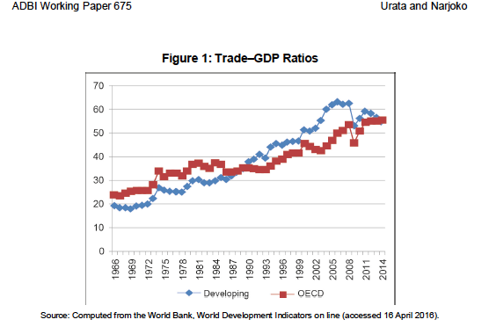
https://www.adb.org/sites/default/files/publication/230591/adbi-wp675.pdf

Slide 5
Lewis
I argue that there is a fundamental conflict between the political economy of domestic renewable energy support and the basic principles of global trade regimes, with direct implications for nations’ abilities to transition to low carbon economies.
For governments to garner political support for renewable energy technologies, they must promise job creation and domestic technological progress, both of which compel direct interventions with international trade flows and may conflict with multiple WTO provisions and domestic trade laws.

Slide 6
Hoberg’s version: Why climate action is so hard politically
Cost of Mitigation | Benefits of Mitigation
Here | Global
Now | Distant in Time
Relatively certain | Highly uncertain
“The Tragedy of the Atmospheric Commons”
Notes:
Concepts:
global public good
energy system inertia and time lag for response to emission reductions
Absence of compelling focusing events?

Slide 7
Political Economy of Renewable Energy
Governments have a hard time justifying costly* policies to reduce GHG – local costs for global benefits
Tying climate policies more directly to domestic economic activity, jobs, technology leadership reduces this challenge

Slide 8
Trade rules - origins
1948 – General Agreement on Tariffs and Trade (GATT)
World Trade Organization (WTO) established in 1995
Subsumed GATT
Trade -related Investment Measures (TRIMS)
Subsidies and Countermeasures
Dispute Settlement

Slide 9
Trade rules
Basic principle: non-discrimination between domestic and foreign
WTO/GATT Article III (sec 4) states:
The products of the territory of any contracting party imported into the territory of any other contracting party shall be accorded treatment no less favorable than that accorded to like products of national origin in respect to all laws, regulations and requirements affecting their internal sale, offering for sale, purchase, transportation, distribution, or use.
Also know as “national treatment”: equal treatment of imported and locally produced goods

Slide 10
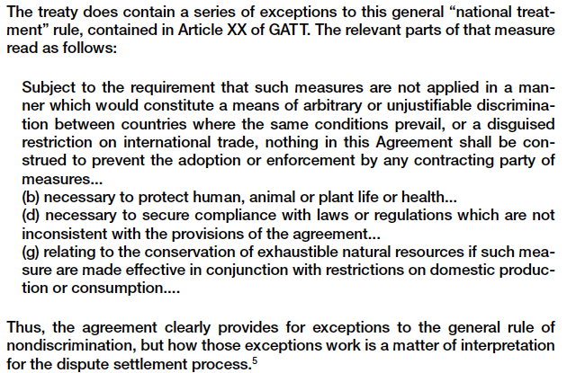
Article XX exemptions
George Hoberg, “Trade, Harmonization, and Domestic Autonomy in Environmental Policy,” Journal of Comparative Policy Analysis 3: 191–217, 2001

Slide 11
Trade disputes - subsidies
US-China over subsidies to solar PV manufacturers
EU-China over subsidies to solar PV manufacturers
Resolved with managed trade agreement: import quote plus floor price
US-China over wind subsidies
India-China over wind subsidies

Slide 12
Trade disputes – local content measures
Japan et al v Ontario over feed-in tariff
US-China wind (settled with China withdrawal)
China et al v EU on FIT
US v India on wind local content

Slide 13
India – Solar Cells https://www.wto.org/english/tratop_e/dispu_e/cases_e/ds456_e.htm
National Solar Mission (provisions)
Generate 100 GW of grid-connected solar by 2022
Graduated requirement that PVs had to manufactured in India
India argued measures justified under Article XX(d) - they secure India's compliance with “laws or regulations” requiring it to take steps to promote sustainable development but WTO panel rejected argument
Appellate Body upheld Panel conclusions appealed by India
Notes:
25 year term offered to solar power developers
A mandatory DCR was imposed on SPDs participating in Phase I (Batches 1 and 2) and Phase II (Batch 1-A) of the NSM. The scope and coverage of the DCR differed, however, across the different Batches.13 Under Phase I (Batch 1), it was mandatory for all projects based on crystalline silicon (c-Si) technology to use c-Si modules manufactured in India, while the use of foreign c-Si cells and foreign thin-film modules or concentrator photovoltaic (PV) cells was permitted.14 Under Phase I (Batch 2), it was mandatory for all projects based on c-Si technology to use c-Si cells and modules manufactured in India, while the use of domestic or foreign modules made from thin-film technologies or concentrator PV cells was permitted.15 Under Phase II (Batch 1-A), any solar cells and modules used by the SPDs had to be made in India, irrespective of the type of technology used.

Slide 14
Canada — Renewable Energy / Feed-In Tariff Program
EU, Japan (other countries) challenged the domestic content requirement of the FIT rules
2012 Panel ruled that DCRs violated rules
Canada, others appealed
Appellate Body agreed with Panel
June 2014 – Ontario informed WTO it would comply
Notes:
https://www.wto.org/english/tratop_e/dispu_e/cases_e/ds426_e.htm
https://www.wto.org/english/tratop_e/dispu_e/cases_e/ds412_e.htm

Slide 15
Debate: should local content requirements be permissible for policies that promote decarbonization?

Slide 16
Race to the bottom - concept
Product standards: industry has an interest in harmonization
Process standards: firms may suffer a competitive disadvantage if the costs of complying with regulations exceed those of their competitors

Slide 17
Race to the bottom - evidence
Surprisingly little evidence
Regulatory costs usually relatively minor component of costs of production
But the higher the percentage and the more mobile the industry, the bigger the concern
Countervailing trend: “California effect”

Slide 18
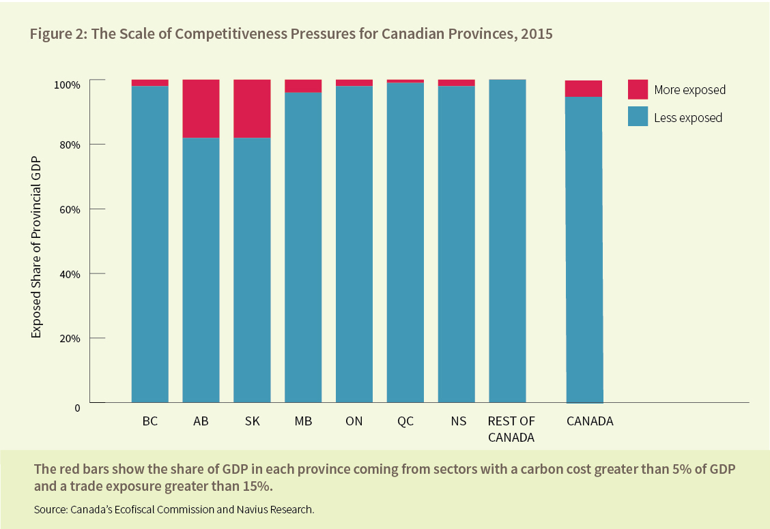
Protecting climate policy from competitiveness effects

Slide 19
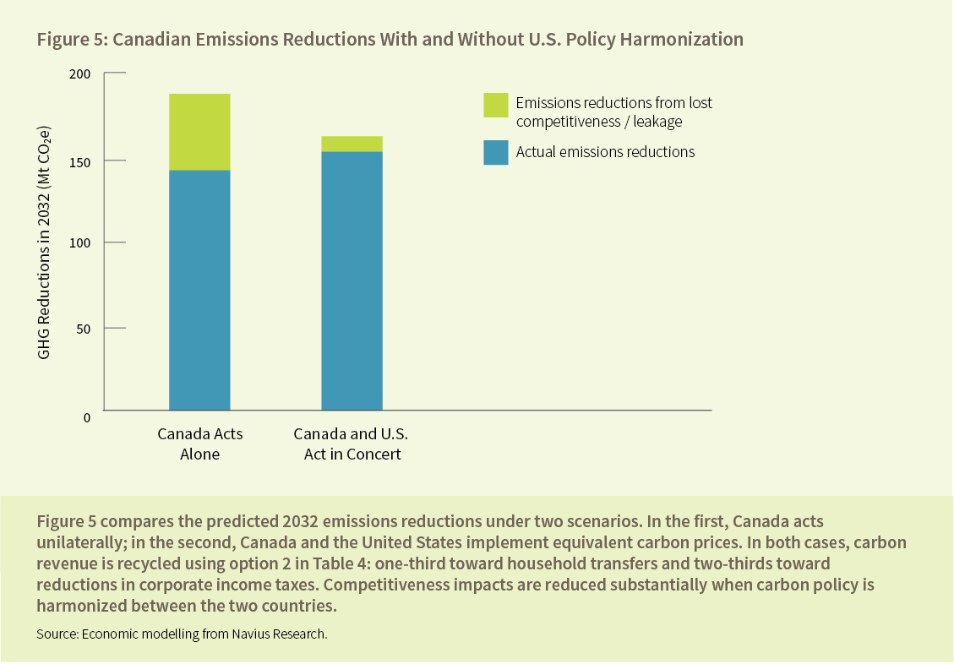
Protecting climate policy from competitiveness effects

Slide 20
Policies to protect leaders (Trachtman)
Issues are both race to bottom and “leakage”
Options:
Border tax adjustment on imports
Border tax adjustment credit for exports
Tax credit mechanisms

Slide 21
Reform options (Lewis)
Revise WTO rules to create specific exemptions
Revise UNFCCC rules to clarify that it’s goals shouldn’t be undermined by WTO rules
Create a Sustainable Energy Trade Agreement

Slide 22
Conclusions
Fragmented international regimes frustrates decarbonization objectives
Aggravates atmospheric tragedy of the commons
Prospects for rule changes seem dim
Next week: reasons for hope

