Slide 1
Energy and Climate Policy in the United States CEEN 525 March 14, 2017

Slide 2
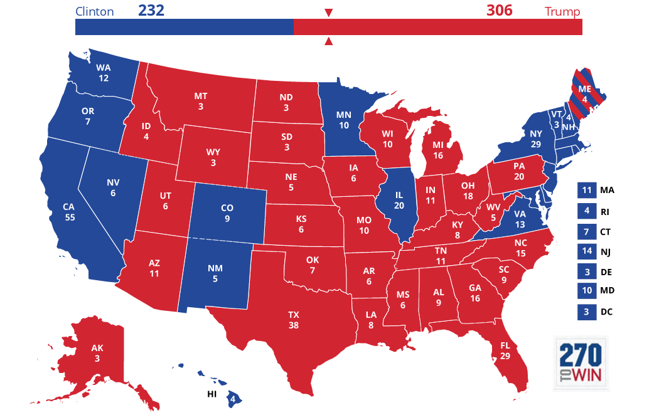
US Energy Policy
US energy system
GHG emissions
Institutions
Climate policy under Obama
Trump’s proposed dismantling
The California model
Workshopping papers

Slide 3
US energy system 2015
https://flowcharts.llnl.gov/content/assets/images/energy/us/Energy_US_2015.png

Slide 4
US energy system 2015
https://flowcharts.llnl.gov/content/assets/images/energy/us/Energy_US_2015.png

Slide 5
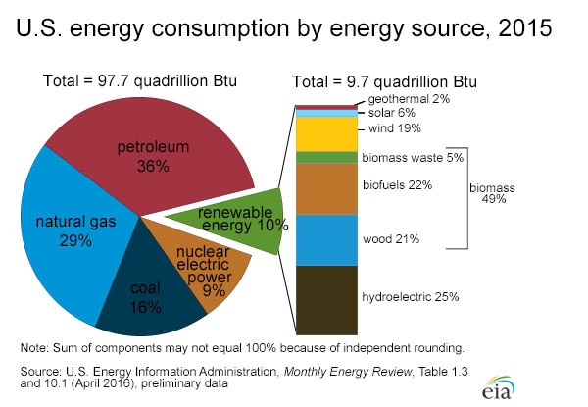
Fossil fuels still 81% of US energy mix

Slide 6
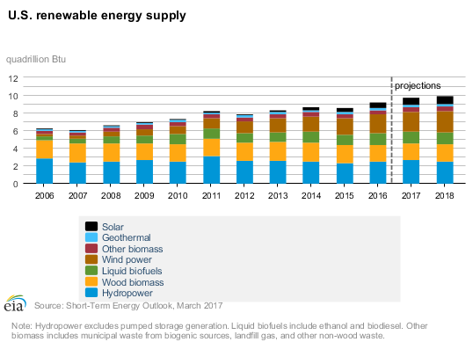
Renewables increasing but not radically

Slide 7
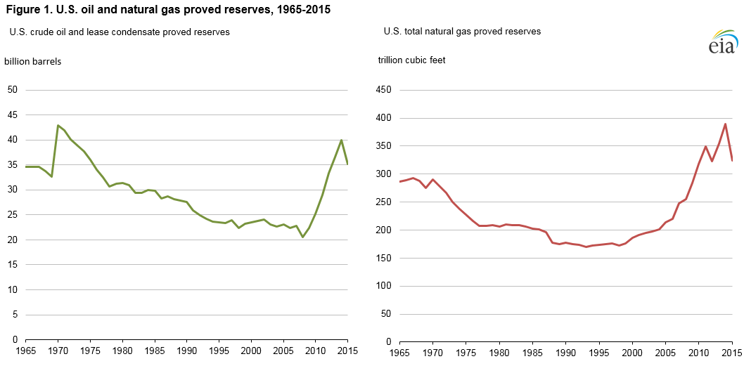
The shale revolution in oil and gas (measure is reserves not production)

Slide 8
Consumption flattens, production soars

Slide 9
Oil production increasing rapidly

Slide 10
Coal on decline, renewables still minor

Slide 11
Electricity: Natural gas supplants coal

Slide 12
US forecasted to become net exporter of energy

Slide 13
US Energy Policy
US energy system
GHG emissions
Institutions
Climate policy under Obama
Trump’s proposed dismantling
The California model
Workshopping papers

Slide 14
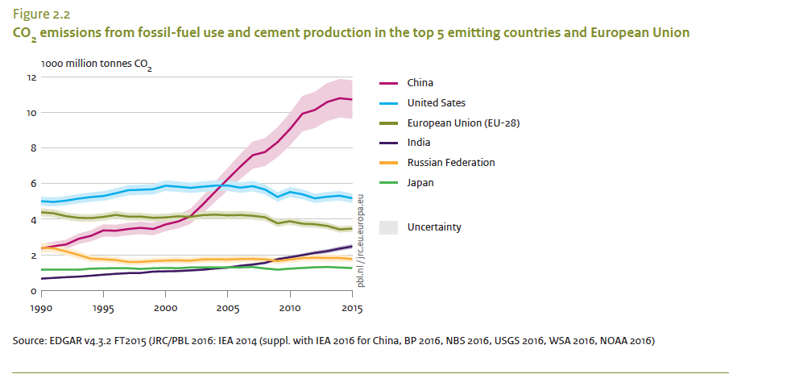
China rockets past US in total emissions
http://edgar.jrc.ec.europa.eu/news_docs/jrc-2016-trends-in-global-co2-emissions-2016-report-103425.pdf

Slide 15
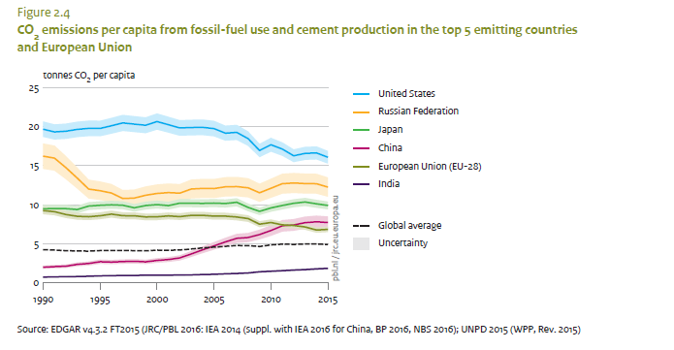
US remarkably high in per capita emissions still more than 2x China
http://edgar.jrc.ec.europa.eu/news_docs/jrc-2016-trends-in-global-co2-emissions-2016-report-103425.pdf

Slide 16
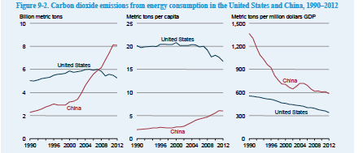
China has surged way beyond US in GHG emissions
EIA International Energy Outlook 2016

Slide 17
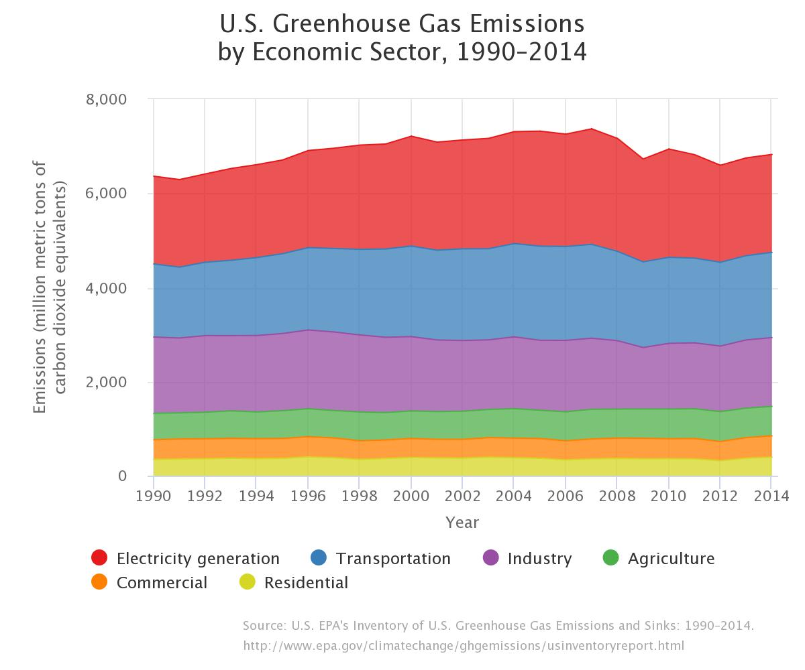
US GHG emissions at 1996 levels
Further reading: Is US on track to meet 2020 and 2025 climate goals?
Notes:
https://www3.epa.gov/climatechange/ghgemissions/inventoryexplorer/#allsectors/allgas/econsect/all

Slide 18
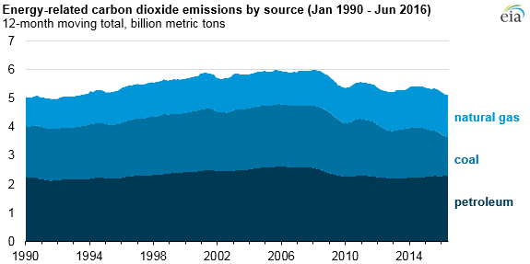
Energy C02 emissions – lowest since 1991
Notes:
https://www.eia.gov/todayinenergy/detail.php?id=28312

Slide 19
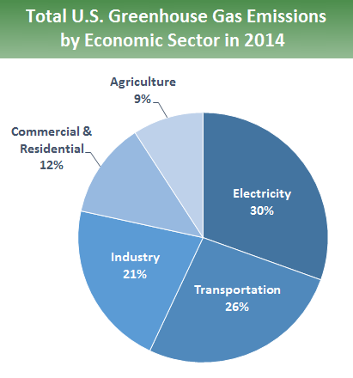
https://www.epa.gov/ghgemissions/sources-greenhouse-gas-emissions

Slide 20
US Energy Policy
US energy system
GHG emissions
Institutions
Climate policy under Obama
Trump’s proposed dismantling
The California model
Workshopping papers

Slide 21
US governance - federalism
Federalism: gives extensive powers to 50 states
Interstate commerce clause gives substantial power to the federal government to regulate
US Clean Air Act
Federal standards implemented by states
Mobile sources – federal standards preempt states
California waiver

Slide 22
US governance – separation of powers
Separation of powers
Congress
2 equal chambers
House – 435 seat elected every 2 years
Senate – 2 seats per state elected every 6 years
President – elected separately every 4 years
Courts

Slide 23
US governance -- extraordinary majorities
House: 50% +1
Senate: effective majority is 60%
Treaties: 2/3rd of Senate requires
President needs to sign laws passed by Congress
If president vetos, 2/3rd of both houses can overturn

Slide 24
US governance: extraordinary majorities
Congress and president same party: working majority is 60%
Congress and president different party: working majority is 67%
Note contrast to Canada, China

Slide 25
Party Balance in Congress
Obama (Democrat)
Trump (Republican)
2009-10 House and Senate Democratic
2011-2016 House Republican, Senate Democratic
2015-6 Senate: 46 D – 54 R
2015-6 House: 188 D – 245R
Senate: 48D 52R
House: 194D 241R

Slide 26
US energy policy history
1973 oil shock prompted
Creation of Department of Energy 1977
Strategic Petroleum Reserve
Corporate Average Fuel Economy Standards
Every president developed a plan but little coherence

Slide 27
US Energy Policy
US energy system
GHG emissions
Institutions
Climate policy under Obama
Trump’s proposed dismantling
The California model
Workshopping papers

Slide 28
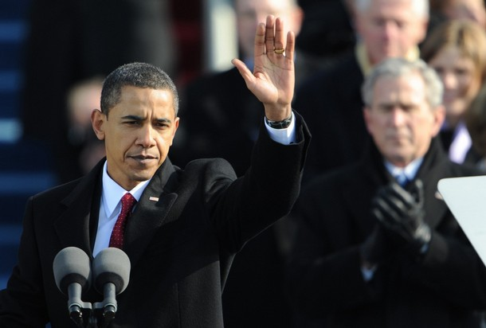
Clinton-Gore 1993-2001 George W Bush 2001-2009
Barack Obama 2009-2017

Slide 29
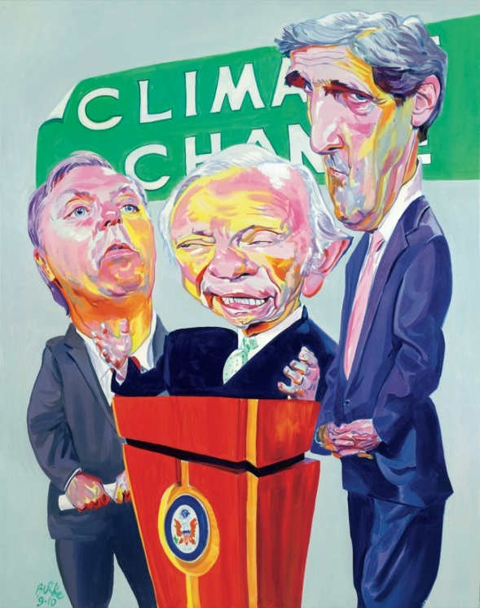
Climate legislation - federal
2009 – House passes Waxman-Markey
17% reduction by 2020
Riddled with concessions
2010 Senate
Coalition building required giving everything away
Coalition of senators fell apart when initiative got framed as “gas tax”
“on climate change, Obama grew timid and gave up, leaving the dysfunctional Senate to figure out the issue on its own” source
Personal impact
http://www.newyorker.com/magazine/2010/10/11/as-the-world-burns

Slide 30
2013 Inaugural: We will respond to the threat of climate change, knowing that the failure to do so would betray our children and future generations.
The path towards sustainable energy sources will be long and sometimes difficult. But America cannot resist this transition, we must lead it. We cannot cede to other nations the technology that will power new jobs and new industries, we must claim its promise. That’s how we will maintain our economic vitality and our national treasure -- our forests and waterways, our crop lands and snow-capped peaks. That is how we will preserve our planet, commanded to our care by God. That’s what will lend meaning to the creed our fathers once declared.

Slide 31
Obama agenda
Try Congress first – cap and trade
Use administration action if that fails
Initial focus on auto standards
2nd term focus on coal
Strong standards on new plants
New coal plants essentially off the table
Clean Power Plan 2015: regulation for existing plants
30% below 2005 levels by 2030
very controversial; currently stayed by court awaiting decision

Slide 32
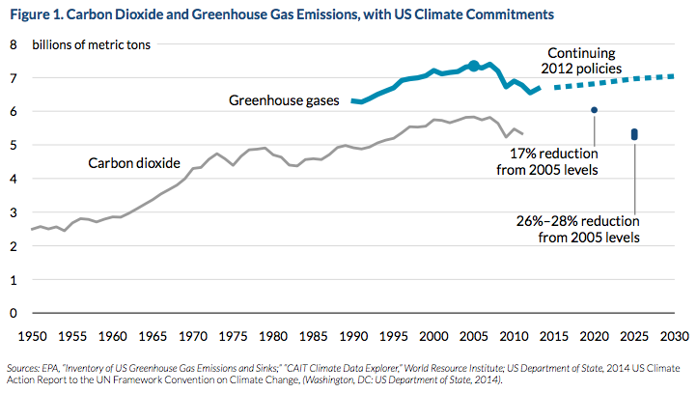
Climate targets
2009 Copenhagen – US pledged to cut emissions 17% below 2005 levels 2020
2015 Paris -- US pledged to cut emissions 26-28% below 2005 levels by 2025
Notes:
http://www.vox.com/cards/obama-climate-plan/what-is-obamas-plan-to-tackle-global-warming

Slide 33
Automobile efficiency standards
2001 – US cars and trucks averaged 24.7 mpg
2011 --29.6 mp
New regs: increase to 55 mpg by 2025
Estimate: 1 billion tonne CO2 reduction by 2030
a 50% reduction in transport GHGS from 2005
a 14% reduction in total GHGs from 2005
Notes:
http://www.time.com/time/health/article/0,8599,2109474,00.html#ixzz1pggMU9KN
(compared to 7.4 BT GHGs in 2005)
Infographics here http://www.whitehouse.gov/energy/gasprices
http://www.ec.gc.ca/default.asp?lang=En&n=714D9AAE-1&news=A10DE3DE-5767-49EA-979B-44D169574367

Slide 34
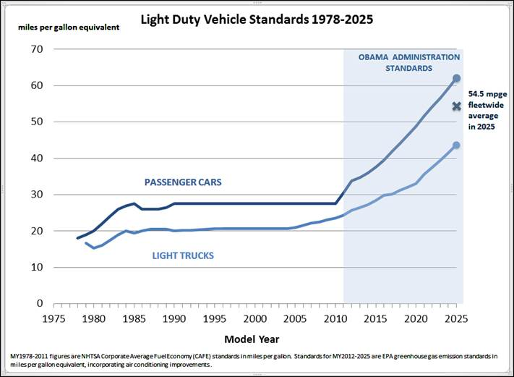
2015 CAFE standards

Slide 35
Power Plants: Clean Power Plan August 2015
EPA will set different emissions targets for each state, based on their existing energy profile. Each state will then have to reduce their rate of emissions a certain amount by 2030.
State plans will cut CO2 from power sector by 30% below 2005 levels by 2030
States can decide how to meet their goal
States had until June 2016 to draw up plans to implement the rule. Deadline stayed by federal court
Estimate: 870 million tonne CO2 reduction by 2030

Slide 36
US Energy Policy
US energy system
GHG emissions
Institutions
Climate policy under Obama
Trump’s proposed dismantling
The California model
Workshopping papers

Slide 38
Trump on climate-energy
American First Energy Plan: For too long, we’ve been held back by burdensome regulations on our energy industry. President Trump is committed to eliminating harmful and unnecessary policies such as the Climate Action Plan and the Waters of the U.S. rule. Lifting these restrictions will greatly help American workers, increasing wages by more than $30 billion over the next 7 years.
https://www.whitehouse.gov/america-first-energy

Slide 39
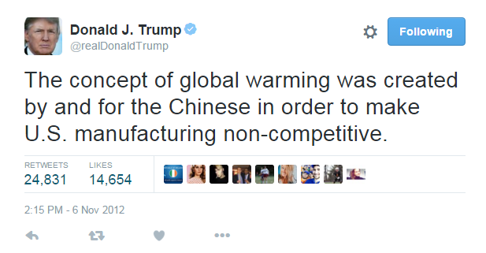
Republicans on climate change

Slide 40
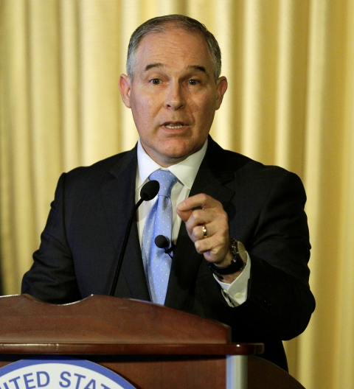
Republicans on climate change
Scott Pruitt (Trump EPA Administrator): “There's tremendous disagreement about the degree of impact [of carbon dioxide], so I would not agree that it's a primary contributor to … global warming.”

Slide 41
Republicans on climate change
“Of all the major conservative parties in the democratic world, the Republican Party stands alone in its denial of the legitimacy of climate science. Indeed, the Republican Party stands alone in its conviction that no national or international response to climate change is needed. To the extent that the party is divided on the issue, the gap separates candidates who openly dismiss climate science as a hoax, and those who, shying away from the political risks of blatant ignorance, instead couch their stance in the alleged impossibility of international action.”
Jonathan Chait

Slide 42
Stephen Bannon’s depiction of Trump agenda: ”the deconstruction of the administrative state”

Slide 43
Trump’s deregulation plans
Defund-discredit-dismantle EPA
Reverse Clean Power Plan
Barrier: Supreme Court ruled (2007) that EPA must regulate CO2 so long as it concludes it “endangers” public heath and welfare
Reverse fuel economy standards
Barrier: ditto
Reverse California waiver

Slide 44
Trump’s UN agreement options
Withdraw from Paris Agreement (4 year lag)
Withdraw from UNFCC (1 year lag)
Refuse to fund financial commitments under Paris accord

Slide 45
Impact on Canada

Slide 46
Keystone XL irony
Lesson learned from Keystone XL controversy: Canada and Alberta’s lack of strong climate policy was a liability for getting access to markets
Alberta adopted “strong” Climate Leadership Plan November 2015
Canada adopted Pan-Canadian Climate Framework December 2016
Trump’s election signals that using stronger climate policy to promote market access irrelevant

Slide 47
Should Canada continue to pursue its climate policies?
Paris target: 30% reduction by 2030
Pan-Canadian Climate Framework
Mandates carbon pricing in all provinces
Graduated carbon price increased to $50/tonne by 2022
Starts at $10/T 2018 increases by $10/year
Exempted if cap and trade meets/exceeds Canada target

Slide 48
US Energy Policy
US energy system
GHG emissions
Institutions
Climate policy under Obama
Trump’s proposed dismantling
The California model
Workshopping papers

Slide 49
State initiatives: Renewable Portfolio Standards

Slide 50
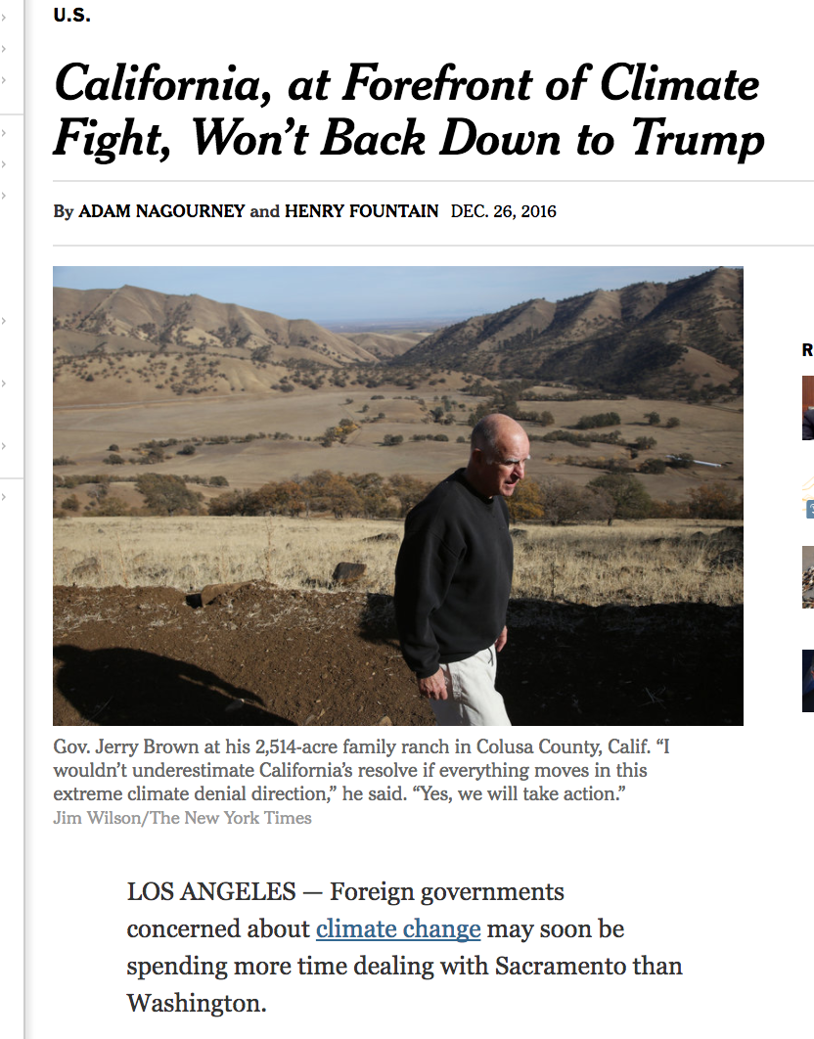

Slide 51
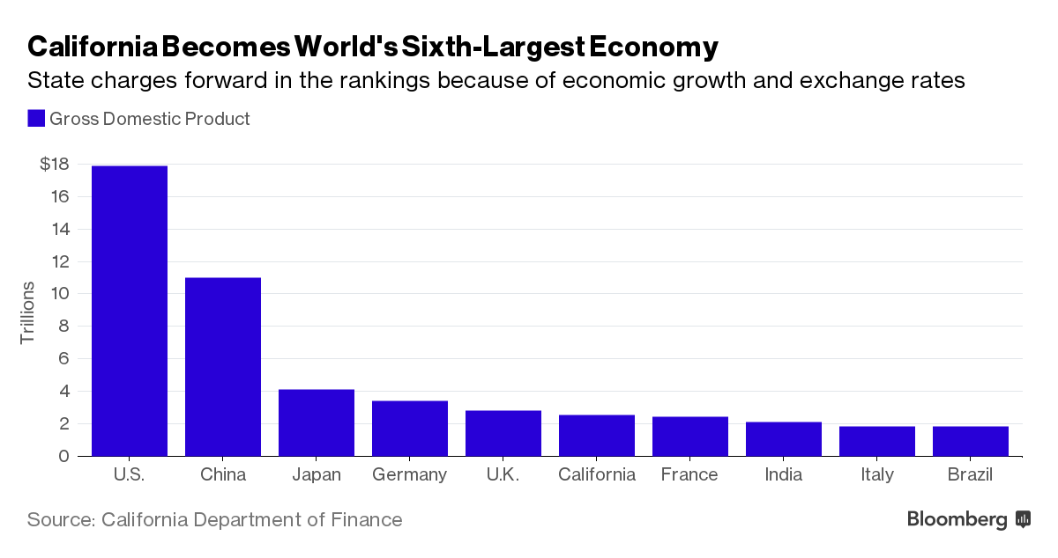
Why California Matters
https://www.bloomberg.com/politics/articles/2016-06-14/california-overtakes-france-to-become-sixth-largest-economy

Slide 52
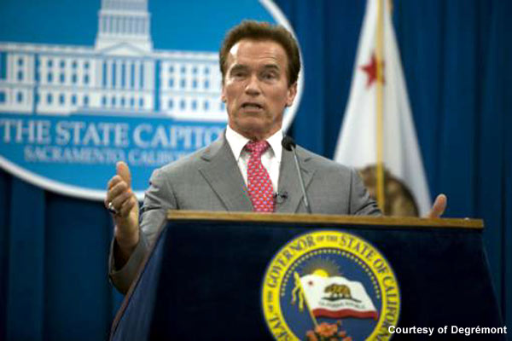
Unlikely climate “hero”
Governor of California 2003-2011

Slide 53
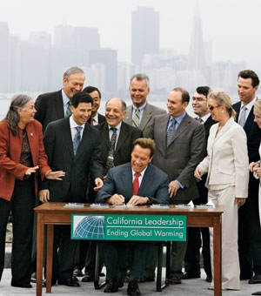
California leadership
GHG policy
Ambition targets:
1990 levels by 2020 (30% reduction)
80% below 1990 levels by 2050
2015 exec order: 40% below 1990 by 2030
Cap and trade program now in place since 2012
Renewable Portfolio Standard
Most ambitious prior to 2015: 33% by 2020
Increased to 50% by 2030 in 2015
Low carbon fuel standard: reduce carbon-intensity of the fuel— 10 percent by 2020

Slide 54
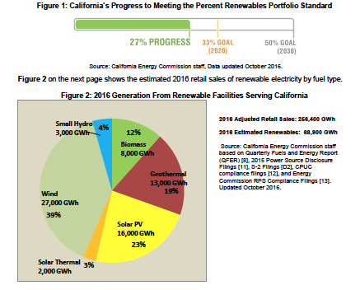
RPS performance
http://www.energy.ca.gov/renewables/tracking_progress/documents/renewable.pdf

Slide 55
CA Cap and Trade
Initial allocation: ½ auctioned, ½ free
Price trends – floor price dominating
Quebec, Ontario joined
Risk of lawsuit
Notes:
https://www.c2es.org/us-states-regions/key-legislation/california-cap-trade

Slide 56
Summary
US energy mix changing
Natural gas supplanting coal, renewables increasing modestly
increased oil and gas production enabling shift to net exporter
Challenged (dysfunctional?) governance
Climate progress for 3 reasons
Shale gas boom
Auto emission standards
Clean Power Plan
Trumps proposes to dismantle Obama policies
California continues progressive leadership
Federal/state conflict looming

Slide 57
March 21: Case Study in Policy Innovation: Germany's Energiewende
E Schmid, A Pechan, B Knopf, “Putting an energy system transformation into practice: The case of the German Energiewende', Energy Research & Social Science 11 (2016): 263–275 DOI:10.1016/j.erss.2015.11.002 open access post-print PDF
Denny Ellerman, Claudio Marcantonini and Aleksandar Zaklan, “The European Union Emissions Trading System: Ten Years and Counting,” Rev Environ Econ Policy (Winter 2016)10 (1): 89-107. doi:10.1093/reep/rev014
Optional: Erik Laes, Leen Gorissen, and Frank Nevens, “A Comparison of Energy Transition Governance in Germany, The Netherlands and the United Kingdom,” Sustainability 2014, 6, 1129-1152.

Slide 58
workshop

