Slide 1
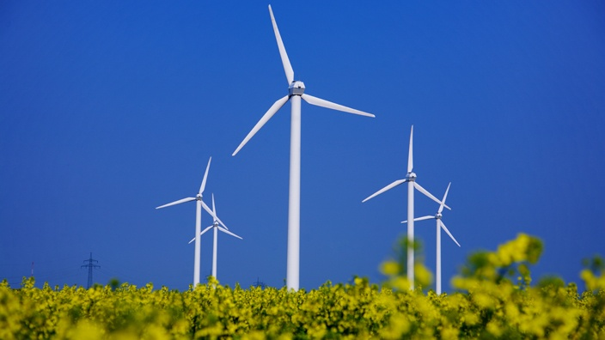
Germany’s Energiewende in European Context
CEEN 525 March 21, 2017

Slide 2
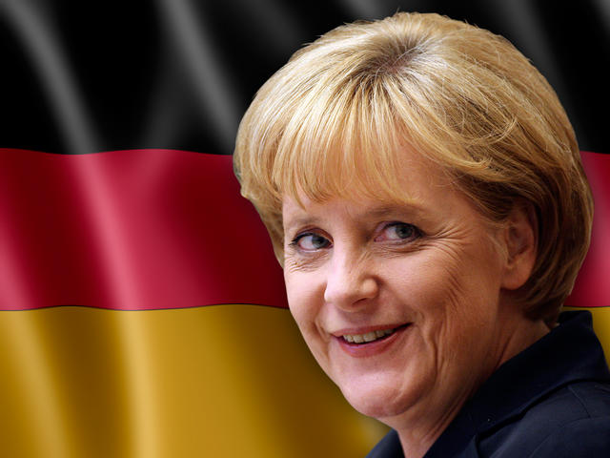
Today’s agenda
German energy system
Energiewende policies
Energiewende origins
Energiewende progress
Energiewende - role of FIT
Cap and trade
EU European Trading System
Notes:
https://www.cleanenergywire.org/dossiers
http://www.bmwi.de/Redaktion/EN/Publikationen/monitoring-report-2016-summary.pdf?__blob=publicationFile&v=11

Slide 3
http://ccap.org/assets/Markus-Kurdziel-Germany.pdf

Slide 4
http://ccap.org/assets/Markus-Kurdziel-Germany.pdf

Slide 6
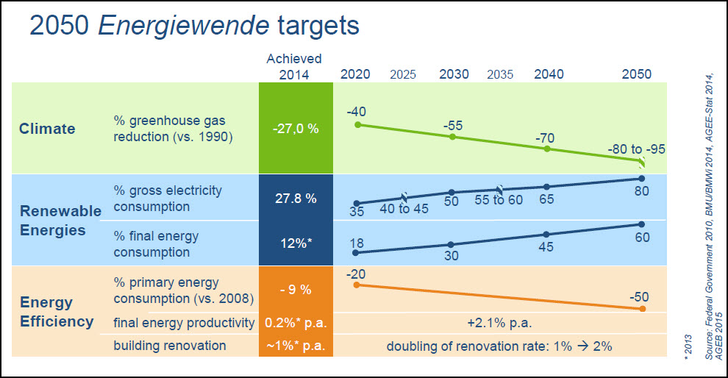
Targets
Nuclear phaseout by 2022 (13% of production in 2016)

Slide 7
Today’s agenda
German energy system
Energiewende policies
Energiewende origins
Energiewende progress
Energiewende - role of FIT
Cap and trade
EU European Trading System

Slide 8
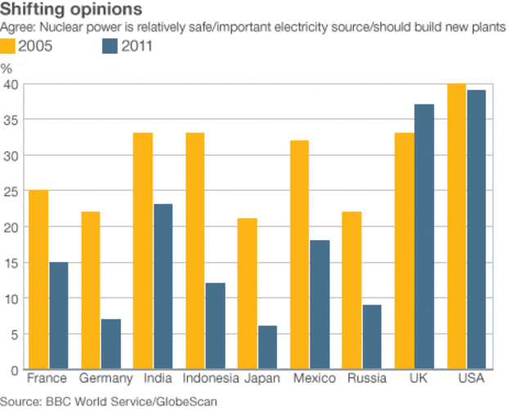
Energiewende origins –
Strong opposition to nuclear energy
http://www.bbc.com/news/science-environment-15864806

Slide 9
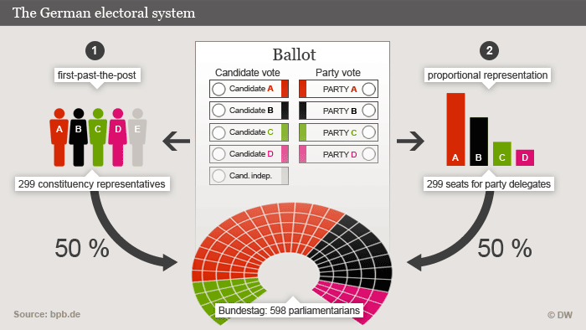
Energiewende origins – electoral system + party structure
http://www.dw.com/en/how-do-germans-elect-their-parliament/a-17018116

Slide 10

Energiewende origins – electoral system + party structure
German Green Party – roots in anti-nuclear movement of 1970s
Part of “Red-Green” governing coalition from 1998-2005

Slide 11
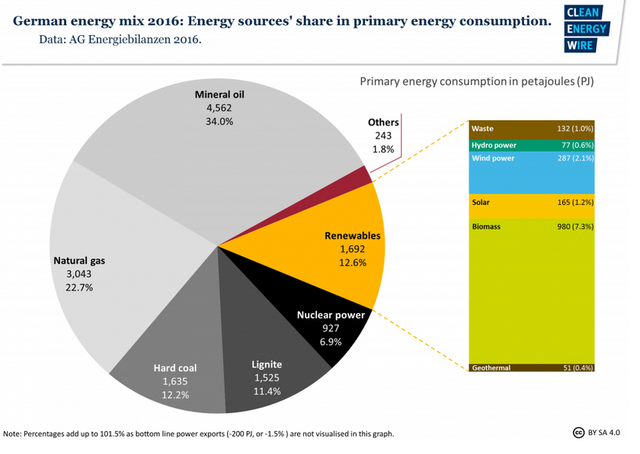

Slide 12
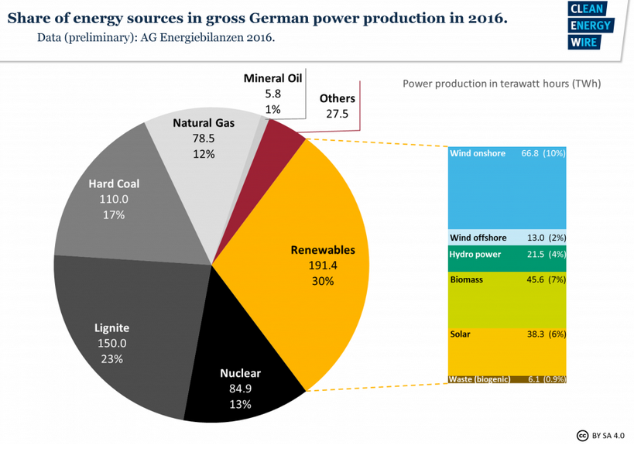

Slide 13
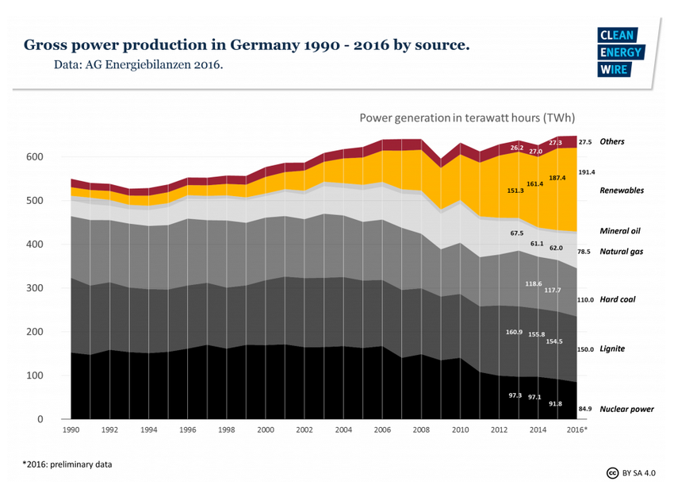

Slide 14
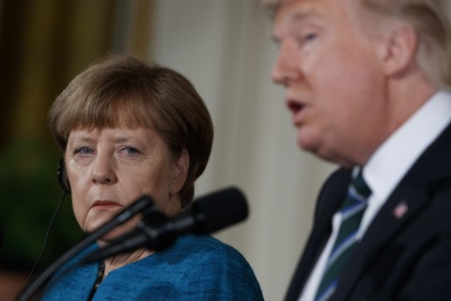
Today’s agenda
German energy system
Energiewende policies
Energiewende origins
Energiewende progress
Energiewende - role of FIT
Cap and trade
EU European Trading System

Slide 15
Core instrument - Feed-in tariff
Renewable Energy Act (EEG) – 1990 – introduced feed-in tariffs: renewable producers received a set payment per kwh for 20 yrs
Notes:
https://www.cleanenergywire.org/factsheets/eeg-reform-2016-switching-auctions-renewables

Slide 16
Solar PV FIT
Feed-in tariffs for newly installed photovoltaic systems paid over 20 years [¢/kWh]
Type |  | 2004 | 2005 | 2006 | 2007 | 2008 | 2009 | 2010 | July 2010 | October 2010 | 2011 | January 2012
Rooftop-mounted | up to 30 kW_{p} | 57.40 | 54.53 | 51.80 | 49.21 | 46.75 | 43.01 | 39.14 | 34.05 | 33.03 | 28.74 | 24.43
 | above 30 kW_{p} | 54.60 | 51.87 | 49.28 | 46.82 | 44.48 | 40.91 | 37.23 | 32.39 | 31.42 | 27.33 | 23.23
 | above 100 kW_{p} | 54.00 | 51.30 | 48.74 | 46.30 | 43.99 | 39.58 | 35.23 | 30.65 | 29.73 | 25.86 | 21.98
 | above 1000 kW_{p} | 54.00 | 51.30 | 48.74 | 46.30 | 43.99 | 33.00 | 29.37 | 25.55 | 24.79 | 21.56 | 18.33
Ground-mounted | conversion areas | 45.70 | 43.40 | 40.60 | 37.96 | 35.49 | 31.94 | 28.43 | 26.16 | 25.37 | 22.07 | 18.76
 | agricultural fields | 45.70 | 43.40 | 40.60 | 37.96 | 35.49 | 31.94 | 28.43 | — | — | — | —
 | other | 45.70 | 43.40 | 40.60 | 37.96 | 35.49 | 31.94 | 28.43 | 25.02 | 24.26 | 21.11 | 17.94
Installations on agricultural fields were removed under the PV Act (2010).

Slide 17
Core instrument - Feed-in tariff
Pro: makes renewables more competitive. Objectively “successful” in promoting renewable penetration
Con: distorts market signals, risks locking in inappropriate technologies
Just eliminated – replaced by auction system
  Government specifics annual renewable additions required, then takes bids in competitive process
Notes:
https://www.cleanenergywire.org/factsheets/eeg-reform-2016-switching-auctions-renewables

Slide 18
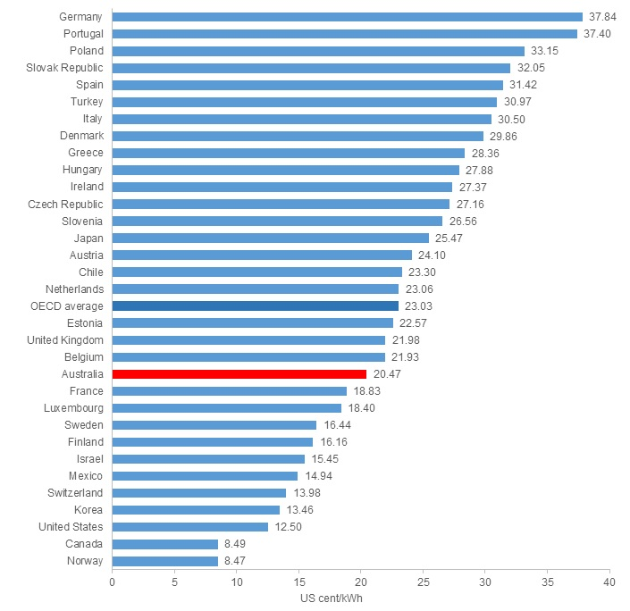
It’s expensive!
2014 data https://www.energycouncil.com.au/analysis/worldwide-electricity-prices-how-does-australia-compare/

Slide 19
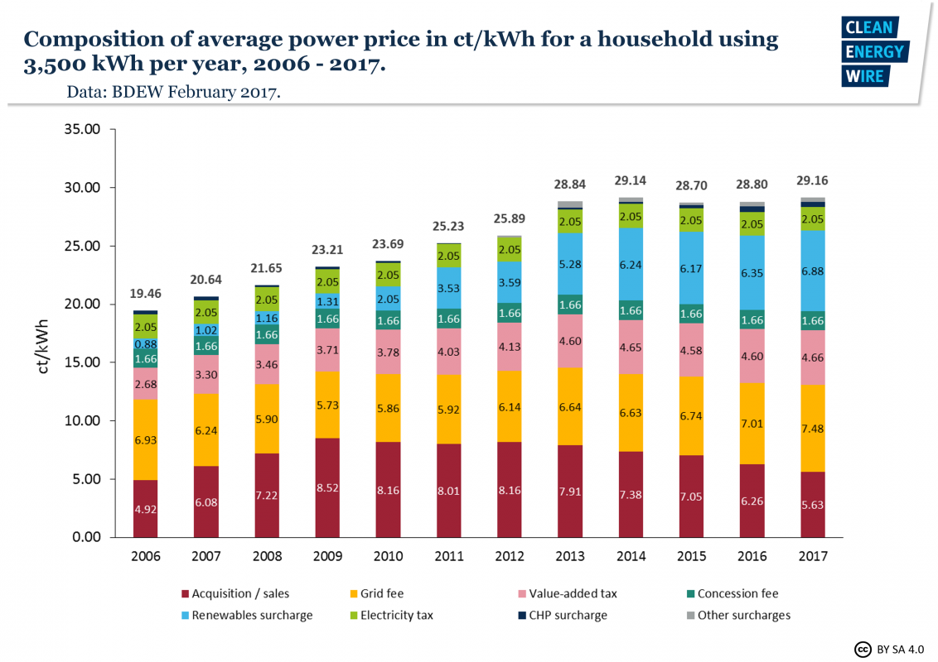

Slide 20
Divergent visions of energy system structure
Discussion of resistance to transmission lines reveal underlying conflict about worldviews of future energy system
As decarbonization moves forward, is more decentralized control of energy desirable? Inevitable?

Slide 21
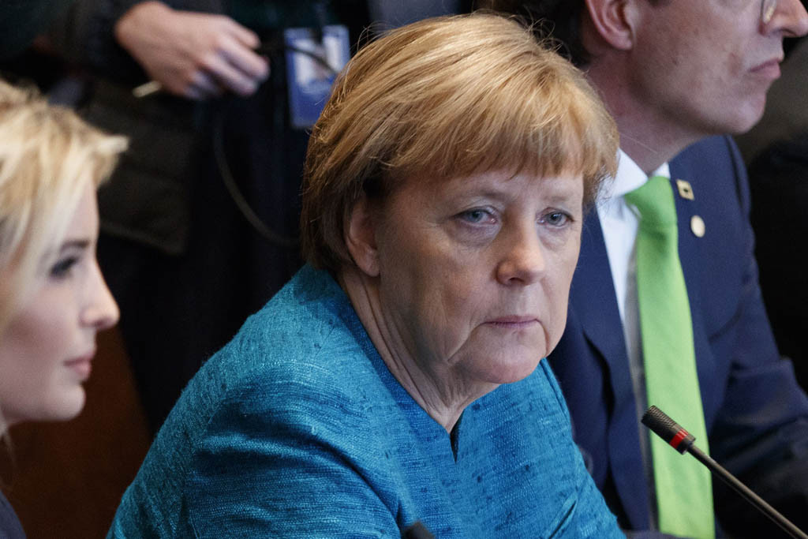
Today’s agenda
German energy system
Energiewende policies
Energiewende origins
Energiewende progress
Energiewende - role of FIT
Cap and trade
EU European Trading System

Slide 22
EU climate policy
20-20-20 by 2020
20% GHG reduction below 1990 levels
20% of total energy consumption from renewables
20% improvement in energy efficiency

Slide 23
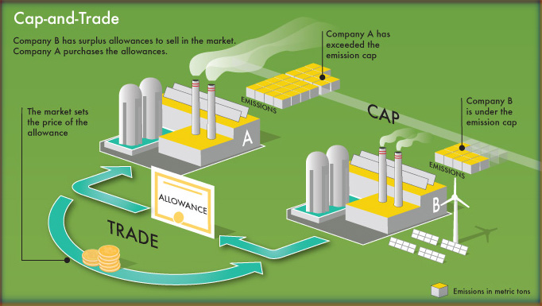
Cap and trade
Notes:
http://www.ncpa.org/pub/understanding-cap-and-trade

Slide 24
EU ETS – cap declines by 1.74% /year
http://carbonmarketwatch.org/wp-content/uploads/2014/07/22_07_14_al_-Sandbag-EP-EU_ETS.pdf

Slide 25
Emissions capped and declining
Ellerman et al

Slide 26
Surprisingly low price

Slide 27
http://www.eea.europa.eu/publications/trends-and-projections-EU-ETS-2016

Slide 28
Debate over surprisingly low price
Critics
Defenders
Not working as intended
Over allocation and abuse of offsets
Can’t produce required transformative energy system change
Working as intended to reduce emissions
Maybe it’s not so expensive

Slide 29
Conclusions from Europe
Progress on decarbonization is possible with sufficient political will
Multiple instruments viable
Policy learning improves performance (FIT, ETS)
Provides model for other regions

Slide 30
Costs workshop

