Slide 1
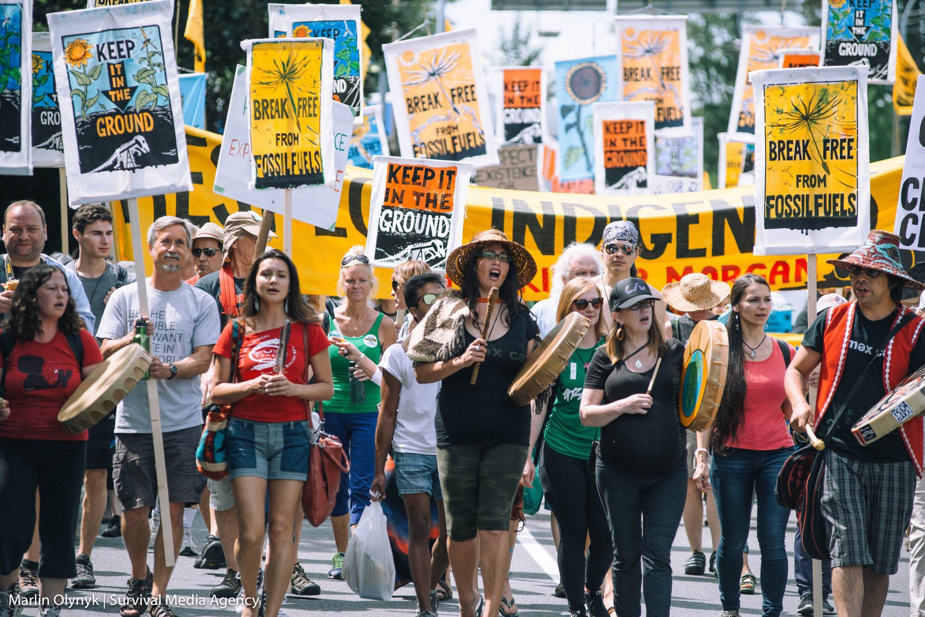
Energy Planning and Approval Strategies, and the Challenge of Social License

Slide 2
Next paper
Mini-brief 3: Your minister has been asked to give a presentation to the International Energy Agency, which has just decided to conduct a review of your country’s energy system and policies. You are tasked with providing an overview of existing energy policy in your jurisdiction as it relates to decarbonization (due March 7 at noon).
In 600-800 words, address the following three issues:
1. Does your government have a formal energy policy? If so, briefly describe its most important components. You might find it helpful to think it terms of policy objectives, policy instruments, and settings on those instruments.
2. Describe the most important objectives of your jurisdiction’s INDC or NDC under the U.N. Framework Convention on Climate Change (UNFCCC)
3. What laws are most relevant to the decarbonization agenda in your jurisdiction? Give specific names and citations.

Slide 3
Today’s issue
How do you sincerely engage local interests in energy decision-making without paralyzing processes to complete projects in the broader public interest?

Slide 4
outline
The energy planning challenge
Strategic planning – BC Hydro Long Term Planning
Project level planning – Environmental Assessment
  Site C Dam case study
Building social acceptance

Slide 5
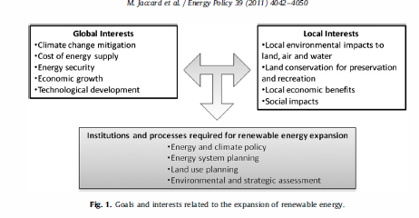
Overview

Slide 6
Energy-related planning processes
Energy and climate policy
Energy system planning
Land use planning
Environmental and strategic assessment
  Project level
  Strategic

Slide 7
Energy and Climate Policy BC
Clean Energy Act Objectives

Slide 8
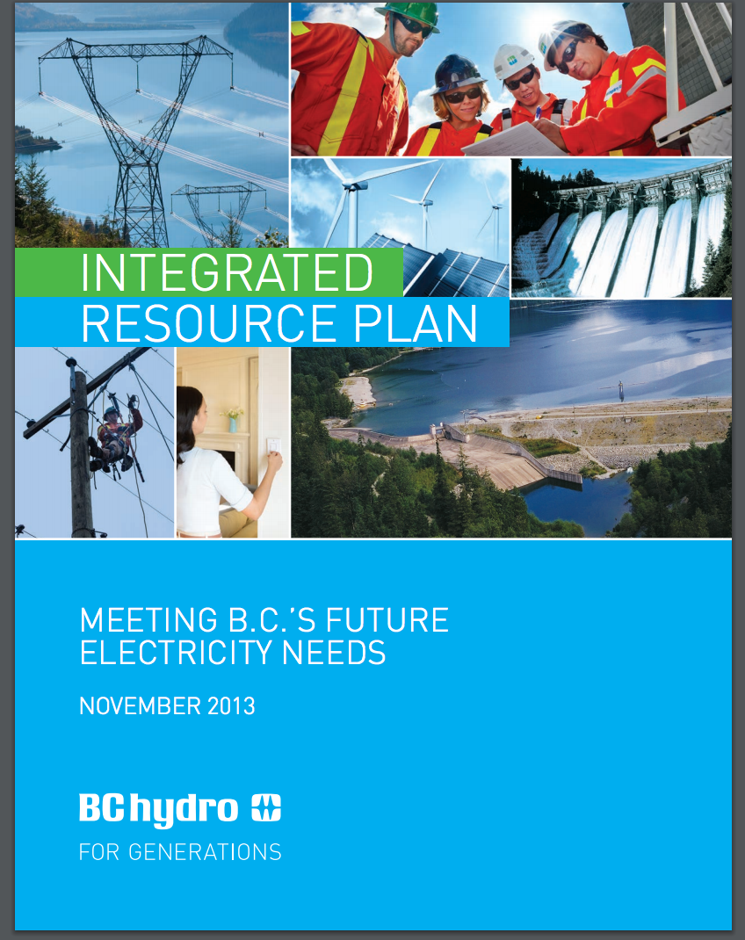
Energy system planning - BC Hydro

Slide 9
BC Hydro - planning
Integrated electricity planning - the long-term planning of electricity generation, transmission, and demand-side resources to reliably meet forecast requirements.

Slide 10
Utility planning
Planning context, objectives
Gross (pre-DSM) demand forecasts
Resources (supply and DSM) – ID and measurement
Develop resource portfolios
Evaluate and select resource portfolios
Develop action plan
Consult
Get approval
Notes:
BCUC Resource Planning Guidelines

Slide 11
Who should make long term plans?
Prior to 2010, long term plans had to be approved by the BC Utilities Commission, an independent regulatory commission
The 2010 Clean Energy Act moved the decision to the cabinet
Who should make long term plans? Elected leaders in the cabinet or expert independent regulators?

Slide 12
Planning Context, Policy Objectives

Slide 13
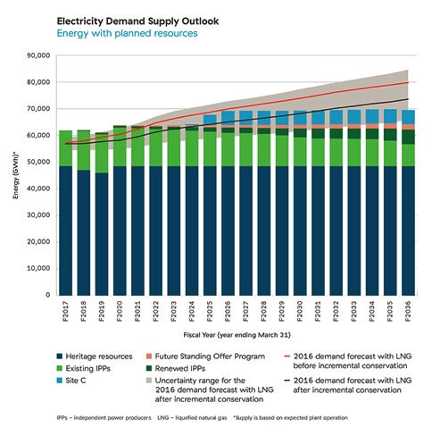
Notes:
https://www.bchydro.com/energy-in-bc/planning-for-our-future/irp/current-plan/2013-irp-review.html

Slide 14
outline
The energy planning challenge
Strategic planning – BC Hydro Long Term Planning
Project level planning – Environmental Assessment
  Site C Dam case study
Building social acceptance

Slide 15
Environmental Assessment
Environmental Assessment as a policy tool: a “procedural policy instrument”
Requires analysis and procedure but does not specify outcome

Slide 16
Stages in EA
Proposal from proponent
Screening – is EA required and if so what kind?
Scoping – what issues?
Assessment of the proposal
Report preparation, submission, and review
Decision: recommendation by EA body, authoritative decision by political body
Monitoring and compliance follow-up

Slide 17
Scope of issues, Kinder Morgan pipeline expansion
The need for the proposed project.
The economic feasibility of the proposed project.
The potential commercial impacts of the proposed project.
The potential environmental and socio-economic effects of the proposed project, including any cumulative environmental effects that are likely to result from the project, including those required to be considered by the NEB’s Filing Manual.
The potential environmental and socio-economic effects of marine shipping activities that would result from the proposed Project, including the potential effects of accidents or malfunctions that may occur.
The appropriateness of the general route and land requirements for the proposed project.
The suitability of the design of the proposed project.
The terms and conditions to be included in any approval the Board may issue.
Potential impacts of the project on Aboriginal interests.
Potential impacts of the project on landowners and land use.
Contingency planning for spills, accidents or malfunctions, during construction and operation of the project.
Safety and security during construction of the proposed project and operation of the project, including emergency response planning and third-party damage prevention.
The Board does not intend to consider the environmental and socio-economic effects associated with upstream activities, the development of oil sands, or the downstream use of the oil transported by the pipeline.
Notes:
http://www.neb-one.gc.ca/clf-nsi/rthnb/pplctnsbfrthnb/trnsmntnxpnsn/trnsmntnxpnsn-eng.html#s4

Slide 18
Scoping controversy –
Kinder Morgan Pipeline
Should upstream effects of pipelines (expansion of oil sands facilities) be considered in pipeline review EAs?
Should downstream effects of pipelines (refining, combustion in markets) be considered in pipeline review EAs

Slide 19
Environmental Assessment –
Federal in Canada
Canadian Environmental Assessment Act
  Came into force in 1995
  applies to projects that require federal approval or permit and are on this list
  Procedures managed by Canadian Environmental Assessment Agency, within Environment Canada
Usually, if federal EA no provincial EA
  But sometime joint like Site C

Slide 20
Site C Dam
1100 MW $9 billion
https://www.sitecproject.com/sites/default/files/site-c-working-group-eis-presentation.pdf

Slide 21


Slide 22
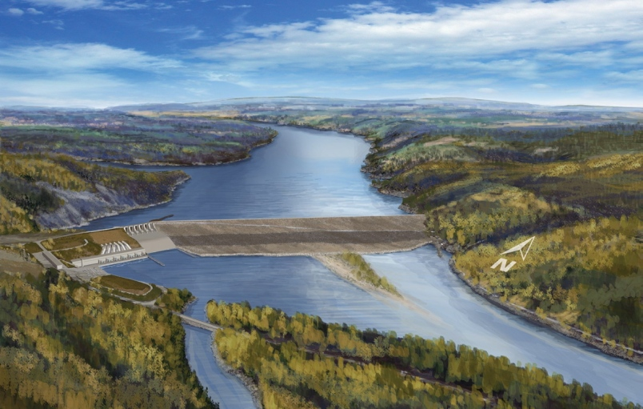

Slide 23
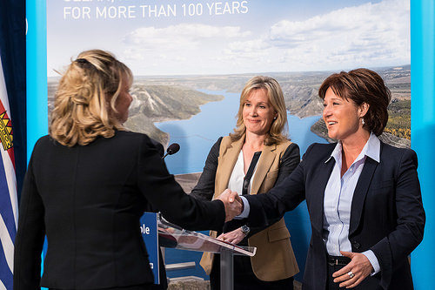
Site C Clean Energy Project
After conservation, demand projections suggest still need more supply
Joint review panel conclusion:
  “The Panel concludes that the Proponent has not fully demonstrated the need for the project on the timetable set forth” (p. 306).
  Recommends that if gov is “inclined to proceed, they may wish to consider” having the BCUC review it
BC cabinet: “Affordable, reliable, clean electricity is the backbone of British Columbia’s economy. Site C will support our quality of life for decades to come and will enable continued investment and a growing economy”

Slide 24
CEAA approval standards
(a) where, taking into account the implementation of any mitigation measures that the responsible authority considers appropriate,
  (i) the project is not likely to cause significant adverse environmental effects, or
  (ii) the project is likely to cause significant adverse environmental effects that can be justified in the circumstances
the responsible authority may exercise any power or perform any duty or function that would permit the project to be carried out in whole or in part
Notes:
http://laws.justice.gc.ca/eng/c-15.2/page-3.html#anchorbo-ga:s_14-gb:s_37

Slide 25
Notes:
http://www.ceaa-acee.gc.ca/050/documents/p63919/100567E.pdf

Slide 26
Should EA procedures allow for the approval of projects likely to cause significant adverse environmental effects?
Should EA’s have time limits?

Slide 27
Project level EA -conclusion
requires elaborate assessment
demonstration of awareness of concerns
consideration of environmental impacts and mitigation measures
but project can still be approved if justified
By forcing agencies to consider environmental consequences, environmental assessment is a critical tool, but it does not affect the balance of values decision-makers ultimately apply

Slide 28
outline
The energy planning challenge
Strategic planning – BC Hydro Long Term Planning
Project level planning – Environmental Assessment
  Site C Dam case study
Building social acceptance

Slide 29
Overview

Slide 30
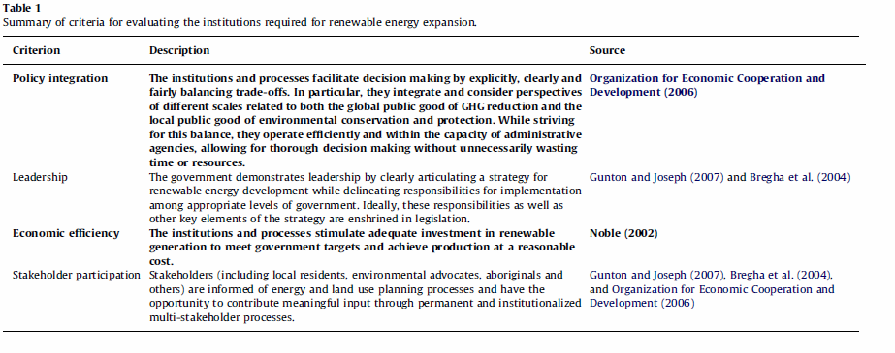
Institutions for renewable energy expansion – criteria (Jaccard et al)

Slide 31
Alternatives, consequences
Jaccard et al
IRP + project specific assessment/approvals
Strategic assessment
risks larger than necessary local environmental effects
Risks less satisfied public
Risks delay in renewable development (and climate change mitigation)
An important tradeoff that needs to be considered in process design

Slide 32
A Matter of Trust

Slide 35
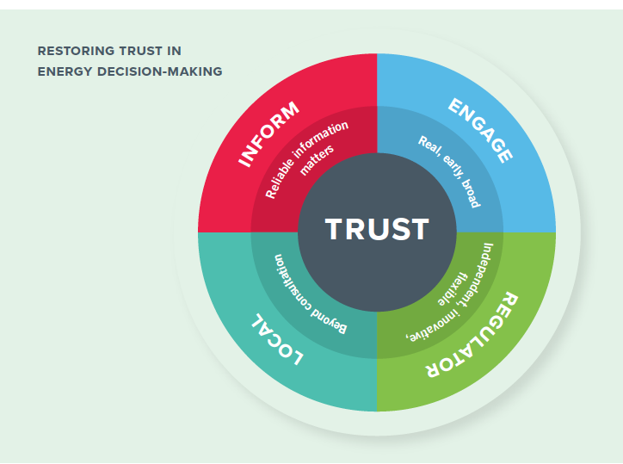

Slide 36
Today’s issue
How do you sincerely engage local interests in energy decision-making without paralyzing processes to complete projects in the broader public interest?
Should local communities have a veto over projects in their jurisdiction?

Slide 37
Review
4 crucial levels of policy and planning
  Integration among levels critical
Significant trade-offs
Transparency
Engagement
legitimacy
Cost-effectiveness
timeliness
Vs.
Social acceptance less likely without significant, sincere investment in process

Slide 38
March 7: Energy Poverty – The Challenge and Case Studies
Antoine Halff, Benjamin K. Sovacool, and Jon Rozhon, Energy Poverty: Global Challenges and Local Solutions, Oxford Scholarship Online, Introduction and Chapter 1, and pick one of Chapters 10-14.
10. Striving Towards Development: China's Energy Poverty Alleviation Efforts, Wenke Han, Luo Zhihong, and Lijuan Fan
11. Indian Approaches to Energy Access, Debajit Palit, Subhes C. Bhattacharyya, and Akanksha Chaurey
12. Modern Energy Services to Low Income Households in Brazil: Lessons Learned and Challenges Ahead, Gilberto De Martino Jannuzzi and Jose Goldemberg
13. Energy Poverty in the Middle East and North Africa, Laura El-Katiri
14. Energy Poverty in Sub-Saharan Africa: Poverty Amidst Abundance, Abeeku Brew-Hammond, Gifty Serwaa Mensah, and Owusu Amponsah

Slide 39
Next paper
Mini-brief 3: Your minister has been asked to give a presentation to the International Energy Agency, which has just decided to conduct a review of your country’s energy system and policies. You are tasked with providing an overview of existing energy policy in your jurisdiction as it relates to decarbonization (due March 7 at noon).
In 600-800 words, address the following three issues:
1. Does your government have a formal energy policy? If so, briefly describe its most important components. You might find it helpful to think it terms of policy objectives, policy instruments, and settings on those instruments.
2. Describe the most important objectives of your jurisdiction’s INDC or NDC under the U.N. Framework Convention on Climate Change (UNFCCC)
3. What laws are most relevant to the decarbonization agenda in your jurisdiction? Give specific names and citations.

