Slide 1
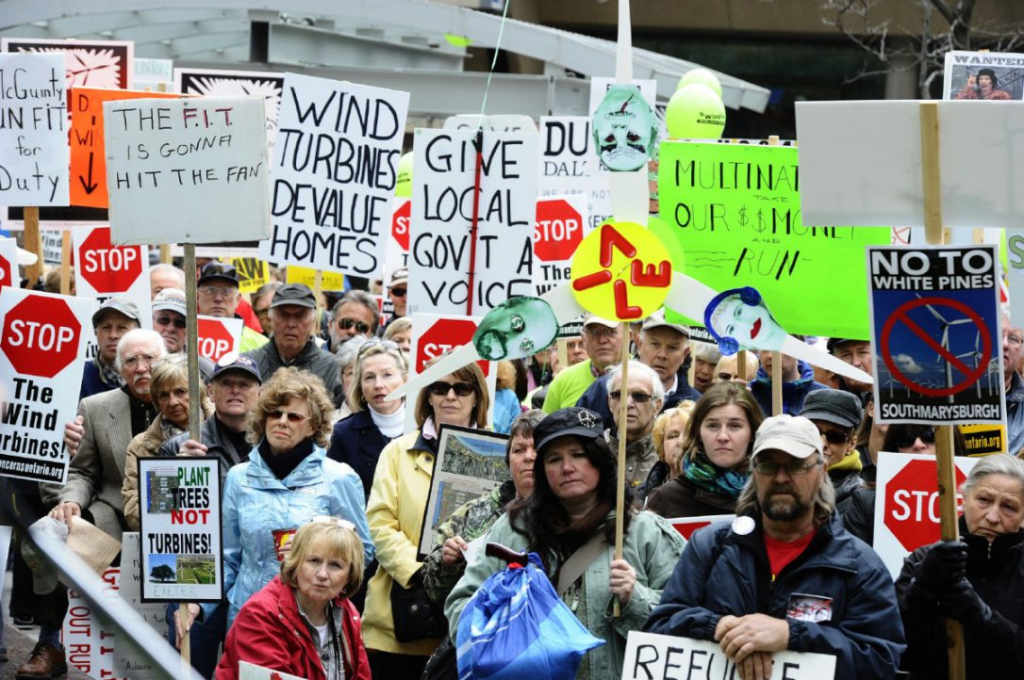
Decarbonization:
The Transition Challenge
CEEN 525 April 4, 2017

Slide 2
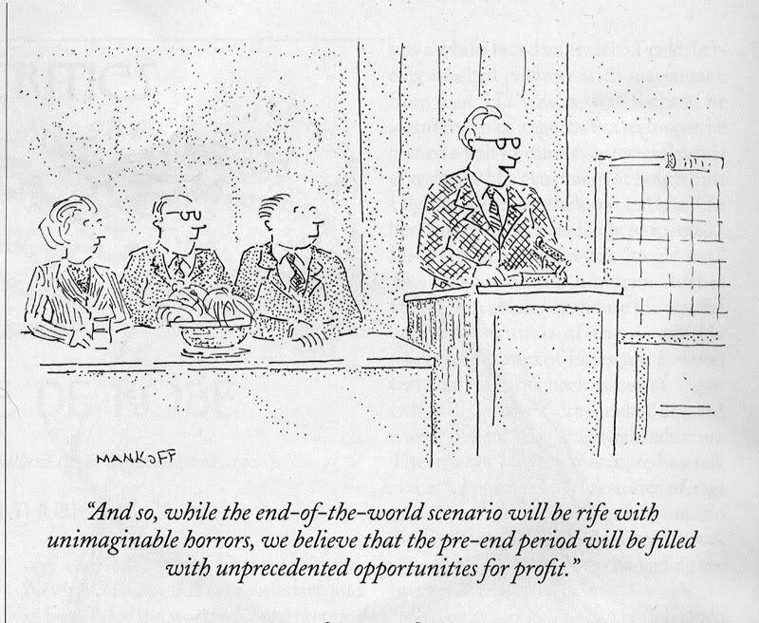
agenda
Course review
Requisite pace of decarbonization
What history suggests
  Pessimists
  Optimists
Psychology: Motivating change
Wrap-up themes

Slide 3
What are the 3 most important and useful things you learned in this class?

Slide 4
Important and useful things
Better understanding political systems and energy governance
Decarbonization strategies and alternative policy instruments
Comparative policies
Energy poverty
Good balance of challenges and opportunities
6 step policy analysis
Mini-brief exercises
Liked MPPGA integration
Mini-brief feedback
Readings were relevant
International scope
Good policy topics
Justification for challenge
Discussion questions

Slide 5
What 3 things did the class cover that you think should be replaced?
What should they be replaced with?

Slide 6
Areas for improvement
Get MJ to come talk
Other guests like AL
Best practices for policy advocacy and implementation
Economics tutorial
½ students think reading load too high
Presentations on policy briefs – maybe presentations
Group projects (minority)
List of topics for term
Sample brief
Poor ergonomic layout from groups
Some selective bias in reading
Take more advantage of diversity through presentations
More participation early on, e.g., country presentations
More justice and social science

Slide 7
agenda
Course review
Requisite pace of decarbonization
What history suggests
  Pessimists
  Optimists
Psychology: Motivating change
Wrap-up themes

Slide 8
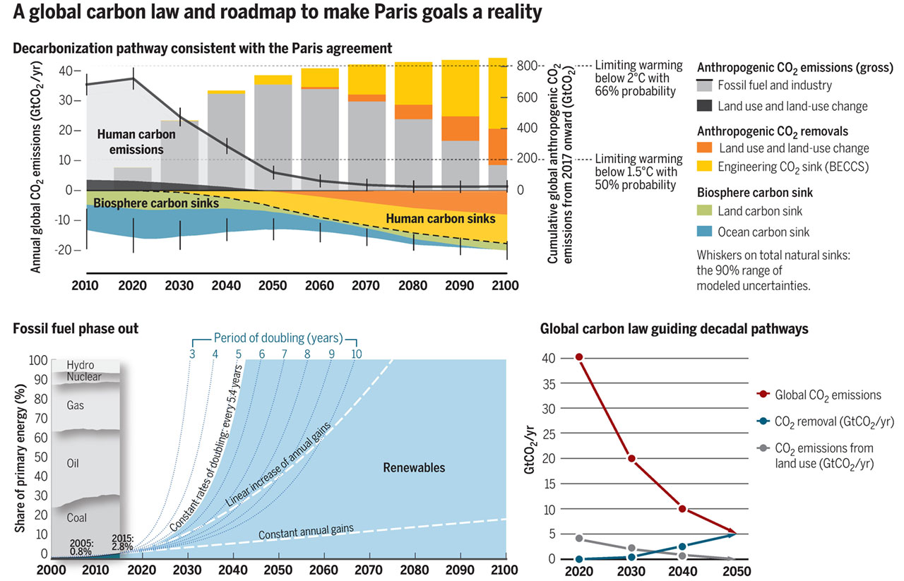

A global carbon law and roadmap to make Paris goals a reality
Johan Rockström et al. Science 2017;355:1269-1271
Published by AAAS
Notes:
A global carbon law and roadmap to make Paris goals a reality (Top) A deep decarbonization scenario scientifically consistent with the Paris Agreement (3) and its associated carbon fluxes as computed with a simple carbon cycle and climate model (13). The “carbon law” scenario of halving emissions every decade is marginally more ambitious than the scenario presented. Meeting the Paris Agreement goals will require bending the global curve of CO₂ emissions by 2020 and reaching net-zero emissions by 2050. It furthermore depends on rising anthropogenic carbon sinks, from bioenergy carbon capture and storage (BECCS) engineering (yellow) and land use (orange), as well as sustained natural sinks, to stabilize global temperatures. This scenario is broadly consistent with a 75% probability of limiting warming to below 2°C; a median temperature increase of 1.5°C by 2100; estimated peak median temperature increase of 1.7°C; a 50% probability of limiting warming to below 1.5°C by 2100; and CO₂ concentrations of 380 ppm in 2100. See supplementary materials (SM). (_{Bottom left}) Nonlinear renewable energy expansion trajectories based on 2005–2015 global trends (13). Keeping the historical doubling times of around 5.5 years constant in the next three decades would yield full decarbonization (blue area) in the entire energy sector by ∼2040, with coal use ending around 2030–2035 and oil use, 2040–2045. Calculations, based on (5), are detailed in SM. (Bottom right) Decadal staircase following a global carbon law of halving emissions every decade, a complementary fall in land-use emissions, plus ramping up CO₂ removal technologies.

Slide 9
Historical Energy Transitions
“Mainstream view” emphasizes the inherently slow pace of energy transitions
Smil definition: energy transition encompasses the time that elapses between the introduction of a new primary energy source (coal, oil, nuclear electricity, wind captured by large turbines) and its rise to claiming a substantial (25%) share of the overall market

Slide 10

Smil on Energy Transitions
Past transitions have take ~ half century
Explanation: essentially a socio-technical system path-dependence argument (carbon lock-in)
Logistical challenges mean plans for transition are a “grand delusion”

Slide 11
Is there any reason to expect the next energy transition could be faster than the previous?
because it better be….

Slide 12
Sovocool on energy transitions

Slide 13
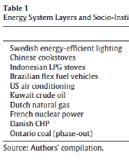

Slide 14
agenda
Course review
Requisite pace of decarbonization
What history suggests
  Pessimists
  Optimists
Psychology: Motivating change
Wrap-up themes

Slide 15
Puzzle:
  Consensus in science community about serious of problem and urgent need to address it
  Lack of awareness and motivation among public and lack of political action
Psychology helps explain – climate change fails to activate our moral intuitions

Slide 18
Using Markowitz and Shariff’s recommendations for effective climate communication, develop a one sentence tagline for your policy brief that will effectively market your recommendations to the public in your jurisdiction.

Slide 19
Justin Trudeau’s 2019
Environmental Platform

Slide 20
agenda
Course review
Requisite pace of decarbonization
What history suggests
  Pessimists
  Optimists
Psychology: Motivating change
Wrap-up themes

Slide 21
Why climate action is so hard politically
Cost of Mitigation | Benefits of Mitigation
Here | Global
Now | Distant in Time
Relatively certain | Highly uncertain
Notes:
Concepts:
global public good
energy system inertia and time lag for response to emission reductions
Absence of compelling focusing events?

Slide 22
Critical Policy Analysis
analytical tool to guide decision-makers on how to choose the best possible course of action given the situation they are facing
Defining your problem
Establishing criteria
Formulating possible alternatives
Analyzing the consequences of alternatives
Comparing alternatives and weighing tradeoffs
Making a recommendation

Slide 23
Well-understood and available policy instruments
Confidence in one or both instruments to price carbon:
  Economy wide carbon tax
  Economy wide cap and trade
Supplementary policies
  Energy R&D
  Regulations to foster sector specific change

Slide 24
Evaluating energy sustainability policy instruments
 | Effectiveness | Efficiency | Administrative Feasibility | Political Feasibility
Info/Persuasion | Poor | Poor | Good | Good
Subsidy | Medium | Poor | Medium | Good
Emission Tax | Medium | Good | Good | Poor
Cap and Trade | Good | Good | Medium | Medium
C&C Regulation | Good | Poor | Good | Medium

Slide 25
Project planning and approval
Project planning and approval is complex
Tradeoffs: quality and coherence vs. political realities

Slide 26
Decarbonization across nations
Different countries face different challenges because of different
  resource endowments
  policy legacies
  political cultures
  Institutions

Slide 27
Energy transitions
Where it has been introduced, policy has been effective at increasing RE penetration but not yet at a scale or rate consistent with what is needed to reach climate goals
Historical transitions have been long and protracted processes, but they were not driven by ambitious government policy

Slide 28
Concluding theme Part 1
Sustainable energy requires that prices reflect their true environmental and social cost
Government action is required to internalize costs
Policy is made by politicians whose core interest is reelection, which discourages them from imposing costs

Slide 29
Climate politics dilemma
Transition to clean energy is feasible and affordable
  But…we are stuck
  Requires politicians to raise energy prices
  Which is improbable without intense social pressure

Slide 30

Affordability – world’s leading environmental economist
“Slowing of climate change to meet the Copenhagen objective of a 2°C limit or something close to it would be a feasible objective. Estimates from economic models suggest that attaining this goal would take between 1 and 2 percent of world income on an annual basis.”
William Nordhaus, Yale University economist
Notes:
Nordhaus, W. (2013). The Climate Casino: Risk, Uncertainty, and Economics for a Warming World. Yale University Press. p. 181
See also Pachauri presentation at http://climatecongress.ku.dk/presentations/congresspresentations/ from IPCC 4

Slide 31
Affordability: IPCC

Slide 32
The major obstacle to energy system transformation is political
Policy is made by politicians
Politicians want to be (re)elected
Politicians respond to public opinion –
  claim credit for good
  avoid blame for bad
Needed policies (pricing carbon) will raise costs
Politicians will only act if they perceive intense public pressure to do so
Notes:
Concepts:
global public good
energy system inertia and time lag for response to emission reductions
Absence of compelling focusing events?

Slide 33
Concluding Theme part 2 profound tension between:
the incentives of politicians to avoid imposing costs
the need to use government action to increase prices

Slide 34
Overcoming obstacles
Transform incentives from short term material interest to “right thing to do”
Politicians “lead” – move beyond electorate
Or
Electorate creates incentives for politicians to act
  Organize
  Mobilize

Slide 35

Notes:
http://www.britannica.com/bps/media-view/129353/1/0/0

Slide 36

Tahrir Square, February 11, 2011
Notes:
http://upload.wikimedia.org/wikipedia/commons/f/f3/Tahrir_Square_on_February11.png

Slide 37
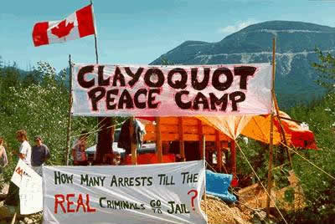

Slide 38
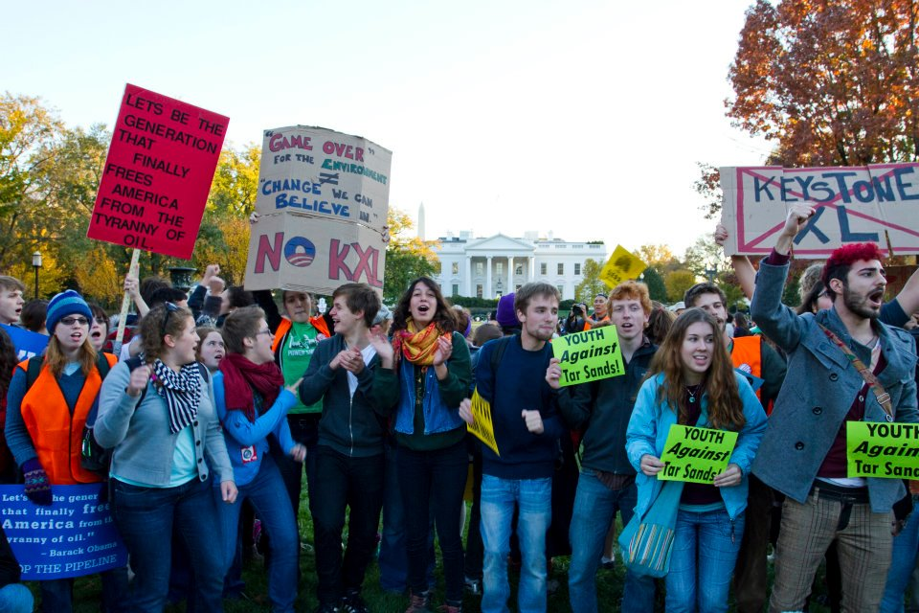

Slide 39
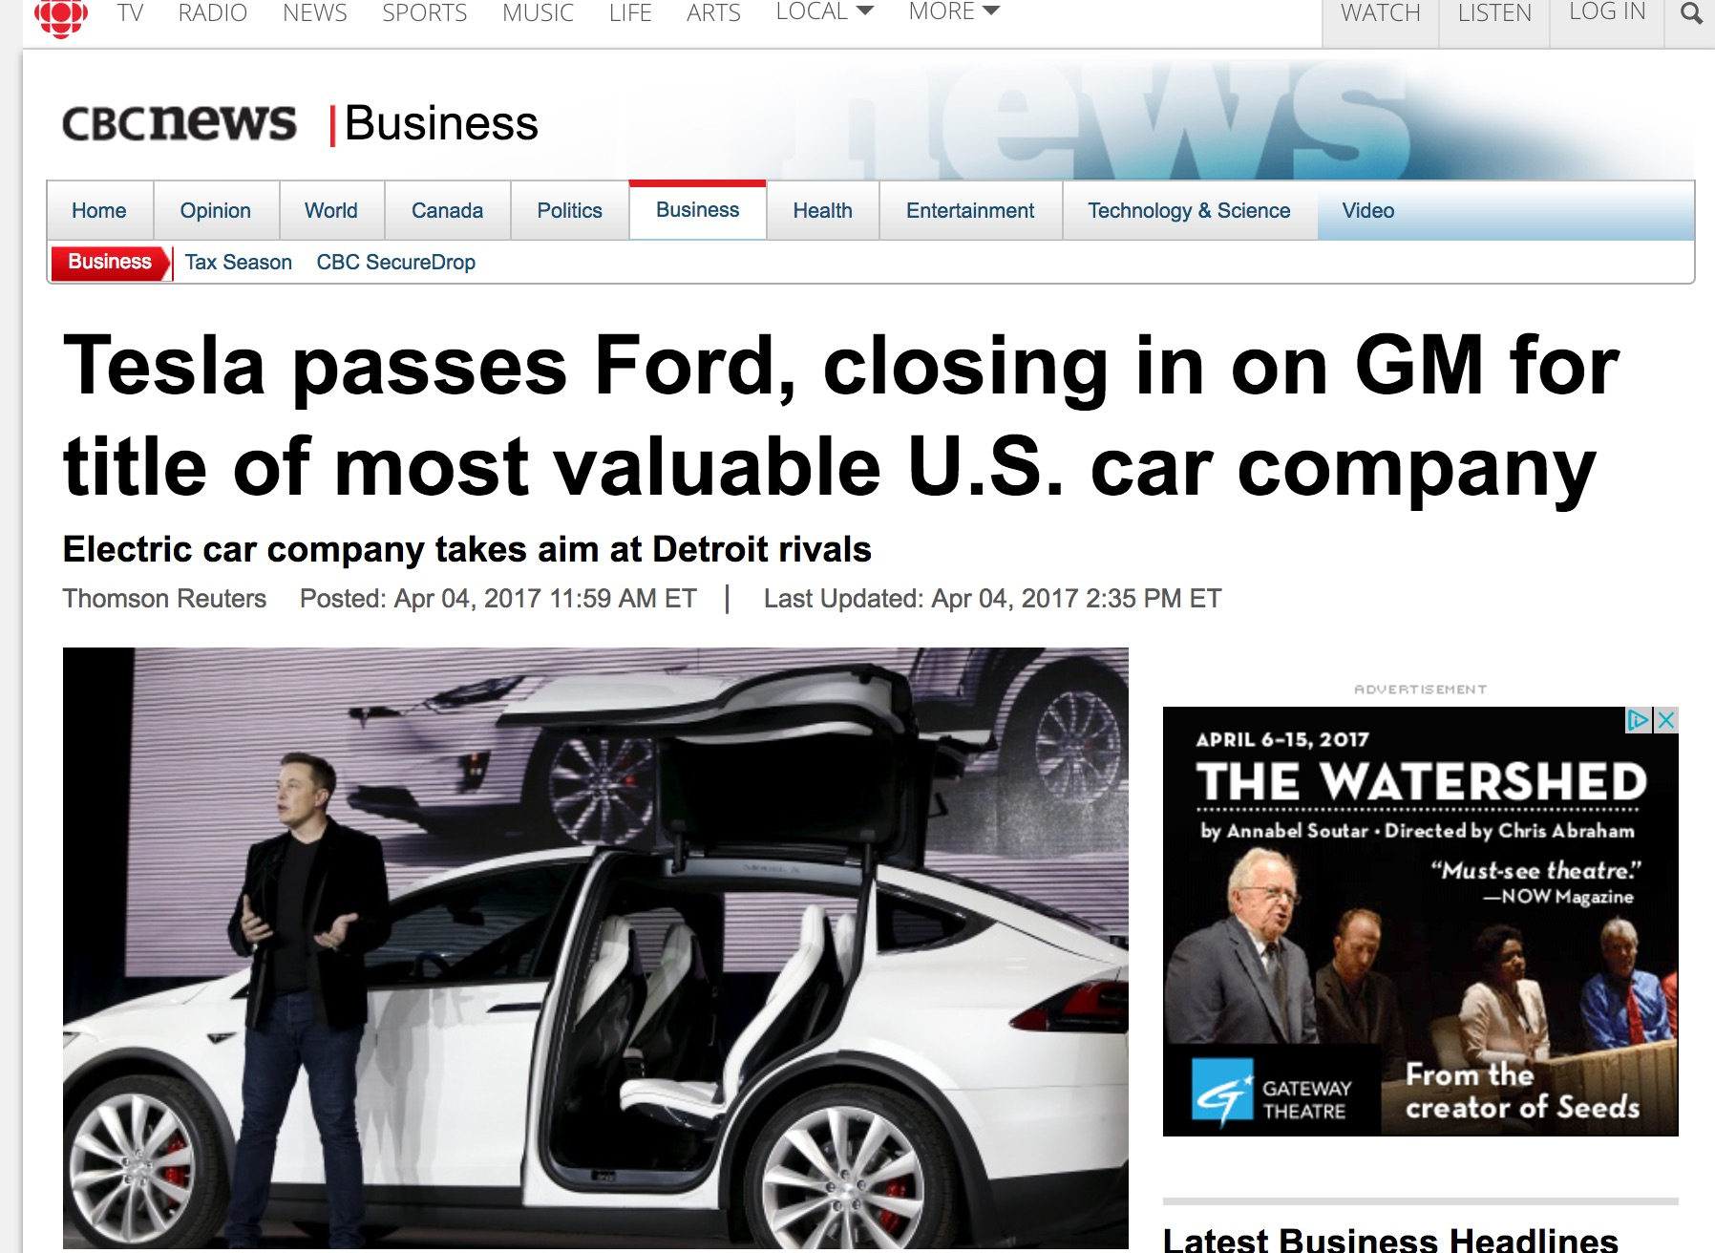

Slide 40

Keep in touch!
George.hoberg@ubc.ca
Twitter @ghoberg

