Slide 1
CEEN 525 – Energy Policy Introduction – January 10

Slide 2
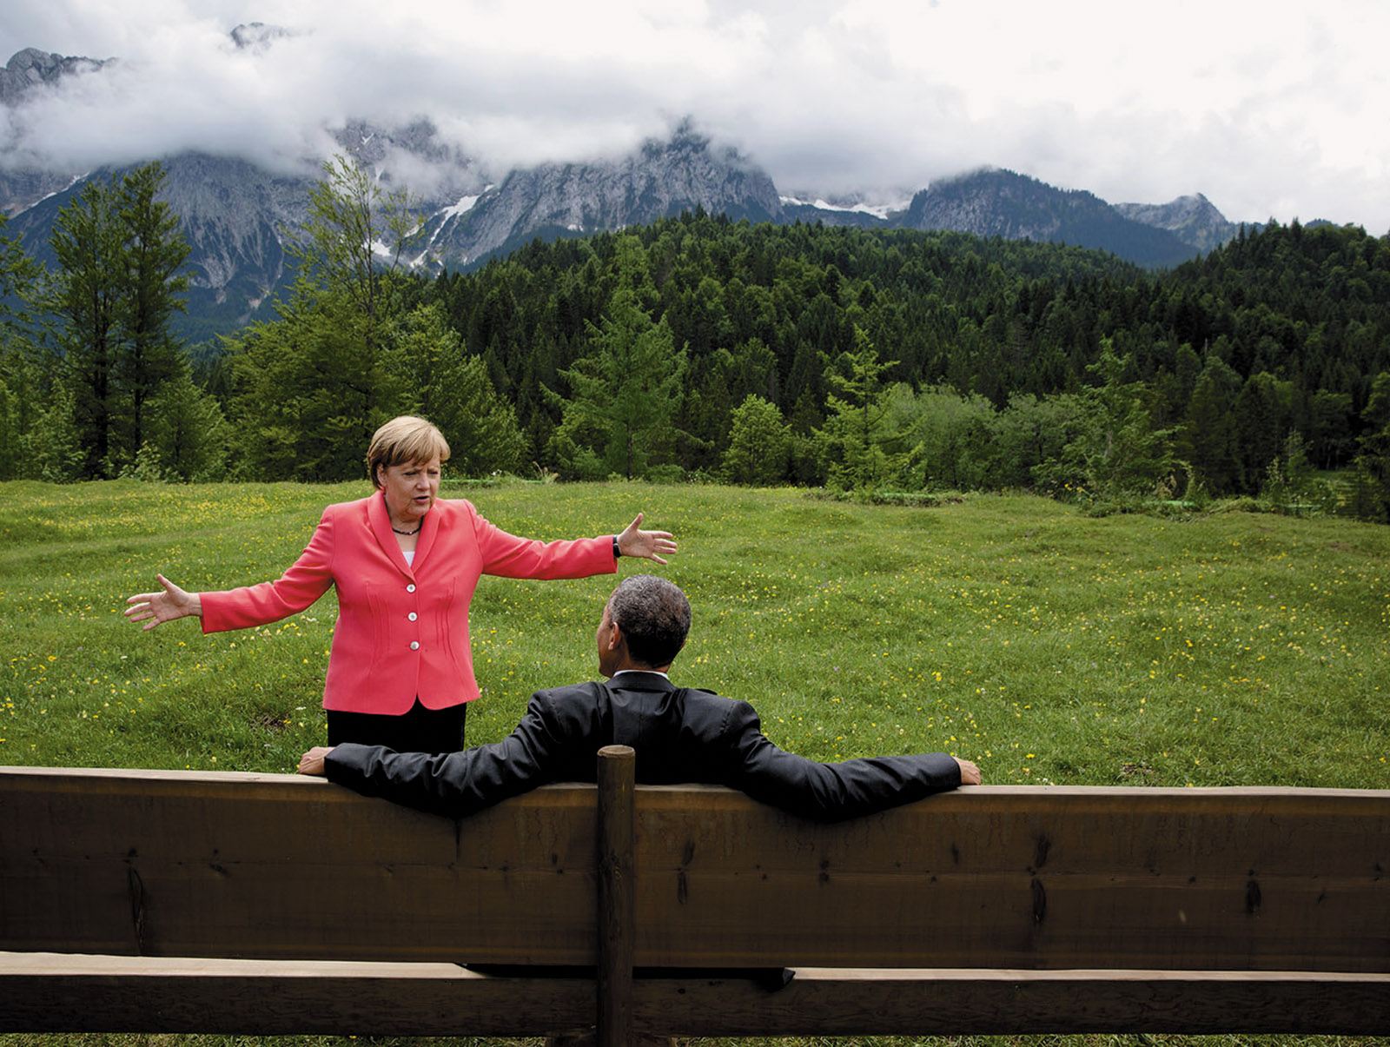
Today’s agenda
Go over syllabus
“Deep decarbonization”
Policy brief assignment
Introductions
Next week

Slide 4
3 pillars of decarbonization

Slide 5
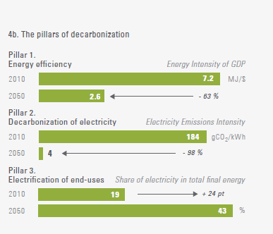
Feasibility – Deep Decarbonization Project in Canada
Sustainable Development Solutions Network, Pathways to Deep Decarbonization – 2014 Report, Canada Chapter. Led by Jeffrey Sachs

Slide 6
Affordability: IPCC
 | GDP Growth
 | Current path | 2° Scenario
2030 | 100% | 98%
2050 | 240% | 236%
Annual global GDP lost by moving from current path to 2° scenario: 0.06%

Slide 7
Government action is needed to drive the clean energy revolution

Slide 8
Policies for the Clean Energy Revolution
Meaningful climate targets (with timeline)
Effective plans to meet those targets
Project planning and approval processes

Slide 9
Major assignment
The major assignment for the course is writing a policy brief to the senior government official responsible for energy policy of a country (or state/province) on policies to achieve decarbonization of a major component of the energy system by 2050.
Apply policy analysis framework
Easier if a DDPP analysis has been done

Slide 10
Mini-briefs
Mini-brief 1: Define your policy problem. Specify 3-4 criteria and 3-4 alternatives (begin in class January 24, due January 31 by noon).
Mini-brief 2: Your minister has been asked to give a presentation to the International Energy Agency, which has just decided to conduct a review of your country’s energy system and policies. You are tasked with providing an overview of your system of government according to the following template (due February 7 in class)
Mini-brief 3: Your minister… You are tasked with providing an overview of existing energy policy in your jurisdiction as it relates to decarbonization (due March 7 at noon).

Slide 11
Full Policy brief
Write a policy brief to the senior government official responsible for energy policy of a significant jurisdiction on policies to achieve decarbonization of a major component of the energy system (e.g., electricity generation, passenger transportation, buildings, etc) by 2050 (or earlier).
Due April 14 by noon.
6000 - 7000 words excluding references (no longer)

Slide 12
January 17: Sustainable Energy as a Social and Political Challenge
David G. Victor, Global Warming Gridlock, (Cambridge: Cambridge University Press, 2011), Chapter 2, “Why global warming is such a hard problem to solve.” (on-line UBC Library http://site.ebrary.com/lib/ubc/docDetail.action?docID=10460494)
Dan Kahan, et al, “The polarizing impact of science literacy and numeracy on perceived climate change risks,” Nature Climate Change 2 (October 2012), 732-5.
Gregory C. Unruh, “Understanding carbon lock-in,” Energy Policy 28 (2000) 817-830.

Slide 13
How to read an academic paper
What’s the main argument (or puzzle)?
What subsidiary arguments support it?
Are there underlying or explicit value assumptions?
What evidence is used to support the argument?
Does the evidence support the argument?
Do other (better?) arguments support the observed outcomes?

